Slide 1

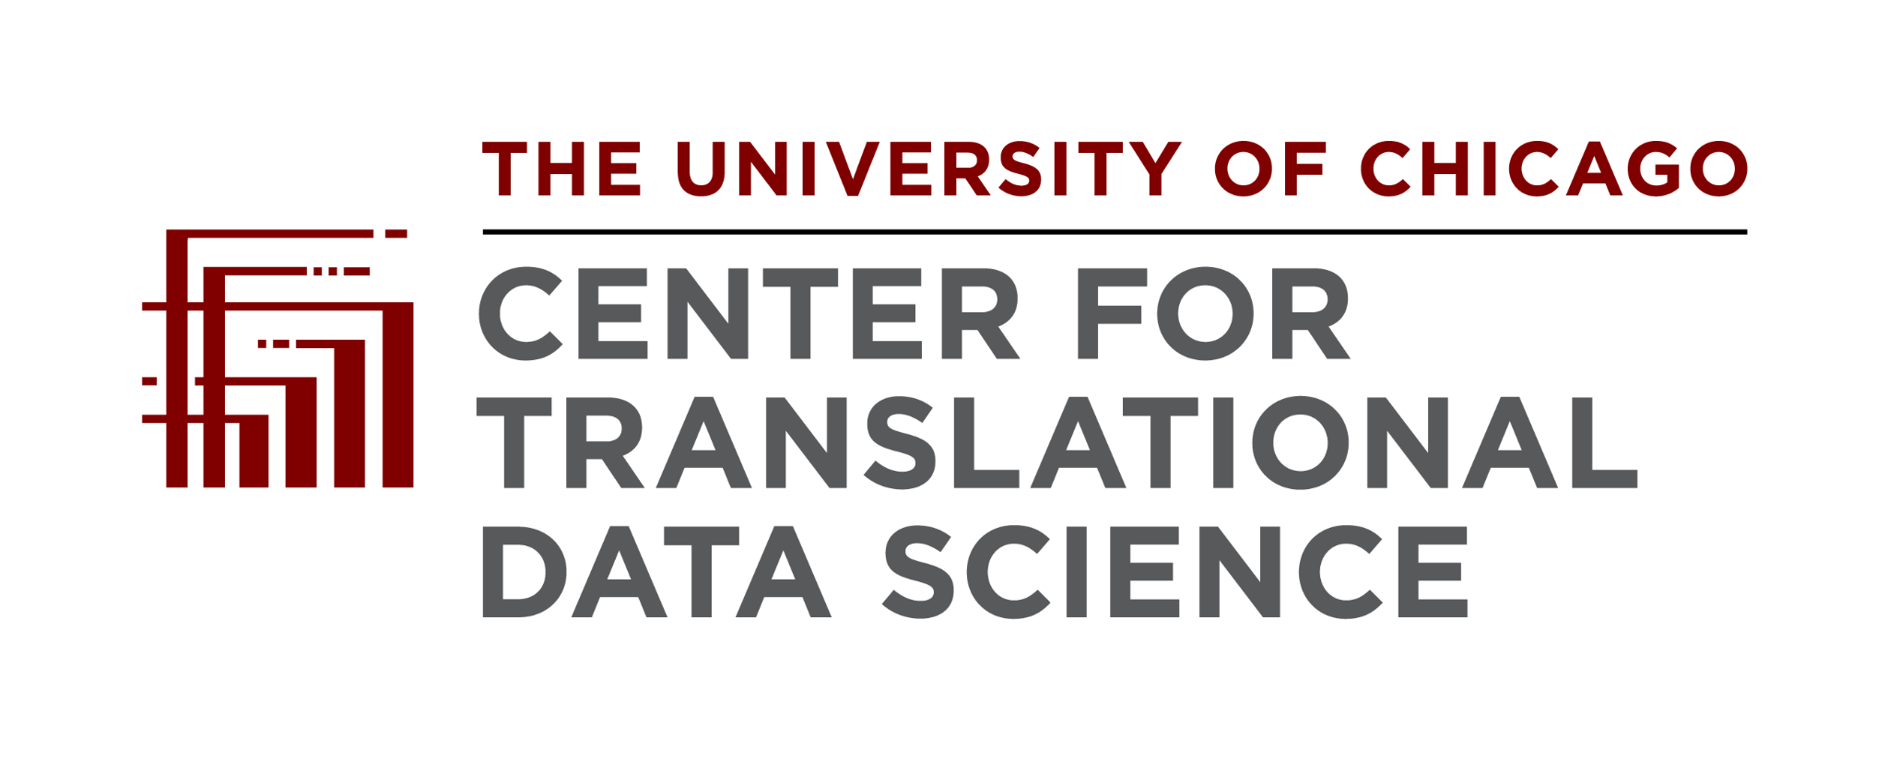



Introduction to Gen3
Gen3 Community Forum
May 6, 2026

Slide 2
The Agenda
What is Gen3 and what problems is it trying to solve?
Gen3 products and features
Using a Gen3 system
Creating and maintaining a Gen3 System
Contributing to Gen3

Slide 3
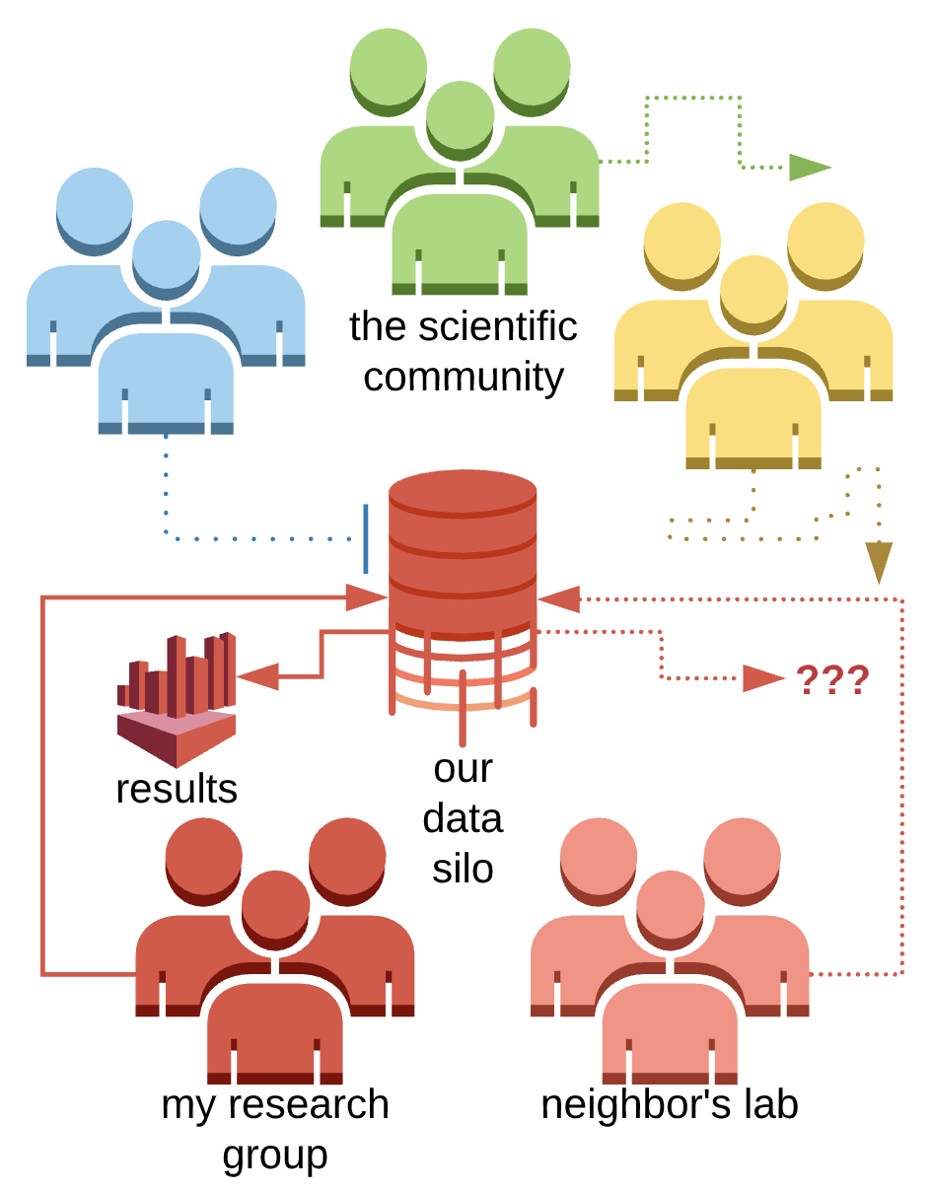
Sharing Research Data Can Be Hard
Low incentive to share: Once data serve their initial purpose, there is lack of effort to open data up to competitors or colleagues. Sponsor requirements are changing this.
Low metadata quality: Data are not well-described wherever they are stored or not quality controlled, which prevents new users from understanding how to use it properly.
System architecture incompatibility: Data are stored on a system that does not provide open APIs or does not use standard protocols for interoperating.

Slide 4
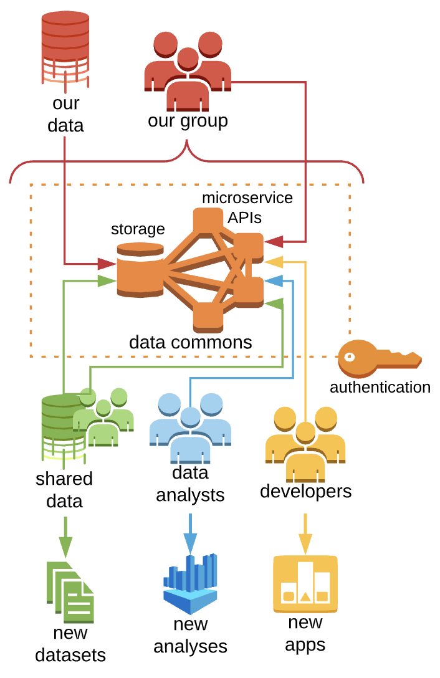
The Gen3 Approach
Data commons provide a secure platform for integrated data management and analysis to the entire scientific research community
Operator can decide on how public the system and data are
Open-source software open to the public to modify or extend
This promotes study reproducibility and accelerates novel discoveries
Standardized software services promotes interoperation / emergence of data meshes

Slide 5
Why Use Gen3? What is FAIR?
Gen3 was designed to make it easy for research communities to create FAIR data commons at minimal cost and technical barrier.
The FAIR principles promote the idea that data should be:
  Findable: Gen3’s metadata and query services index data with unique and persistent identifiers and expose it to queries that run across data resources.
  Accessible: Gen3’s authentication and authorization service provides secure access to data and the portal service provides a web-based user interface for exploring data projects and launching analysis workspaces.
  Interoperable: Gen3 was designed for interoperability, providing open APIs that communicate with clients using common protocols and formats.
  Reusable: Gen3 enforces the use of a data model, which requires data contributors to adopt a common vocabulary when providing patient medical history, data files and their associated metadata.
https://www.go-fair.org/fair-principles/
Notes:
The reason I love Gen3 is that it helps make the data landscape a little more “FAIR”.
What that means is making data findable and accessible to authorized users, and it means only building new systems that are capable of interoperating with other existing or future data resources.
And finally, we do all this for the sake of data reuse, which would be impossible without a system designed to serve well-described and carefully-curated data to users.

Slide 6
Gen3 Features
User authentication and authorization to secure data access and analysis
  Managed manually or synced with external source of authorization such as dbGaP used by NIH
Stores and manages three types of data; each assigned persistent digital IDs (PIDs)
  Structured - Aligns to data dictionary. Used to build cohorts and find files of interest
  Unstructured - Files in a bucket for download or further analysis.
  Semistructured - Used to make project metadata discoverable.
A user interface for data management, exploration, and analysis
Data can be queried via API and within the GUI
Analysis workspaces are included that allow analysis of data without download by using popular tools like R and Python
Cloud-agnostic: can be deployed on any cloud, on-prem system, or local location (AWS, Azure, Google, etc.).

Slide 7
Gen3 Features
Open-source software maintained by the Center for Translational Data Science at the University of Chicago with robust community input and contribution
Micro-services based
Deployment of services and containerized workflows are managed by Kubernetes, with Helm used for automating deployment. Observability tools are included.
Secure data sharing - CTDS runs its systems at FedRAMP moderate and so Gen3 has regular patches to maintain this level of compliance

Slide 8
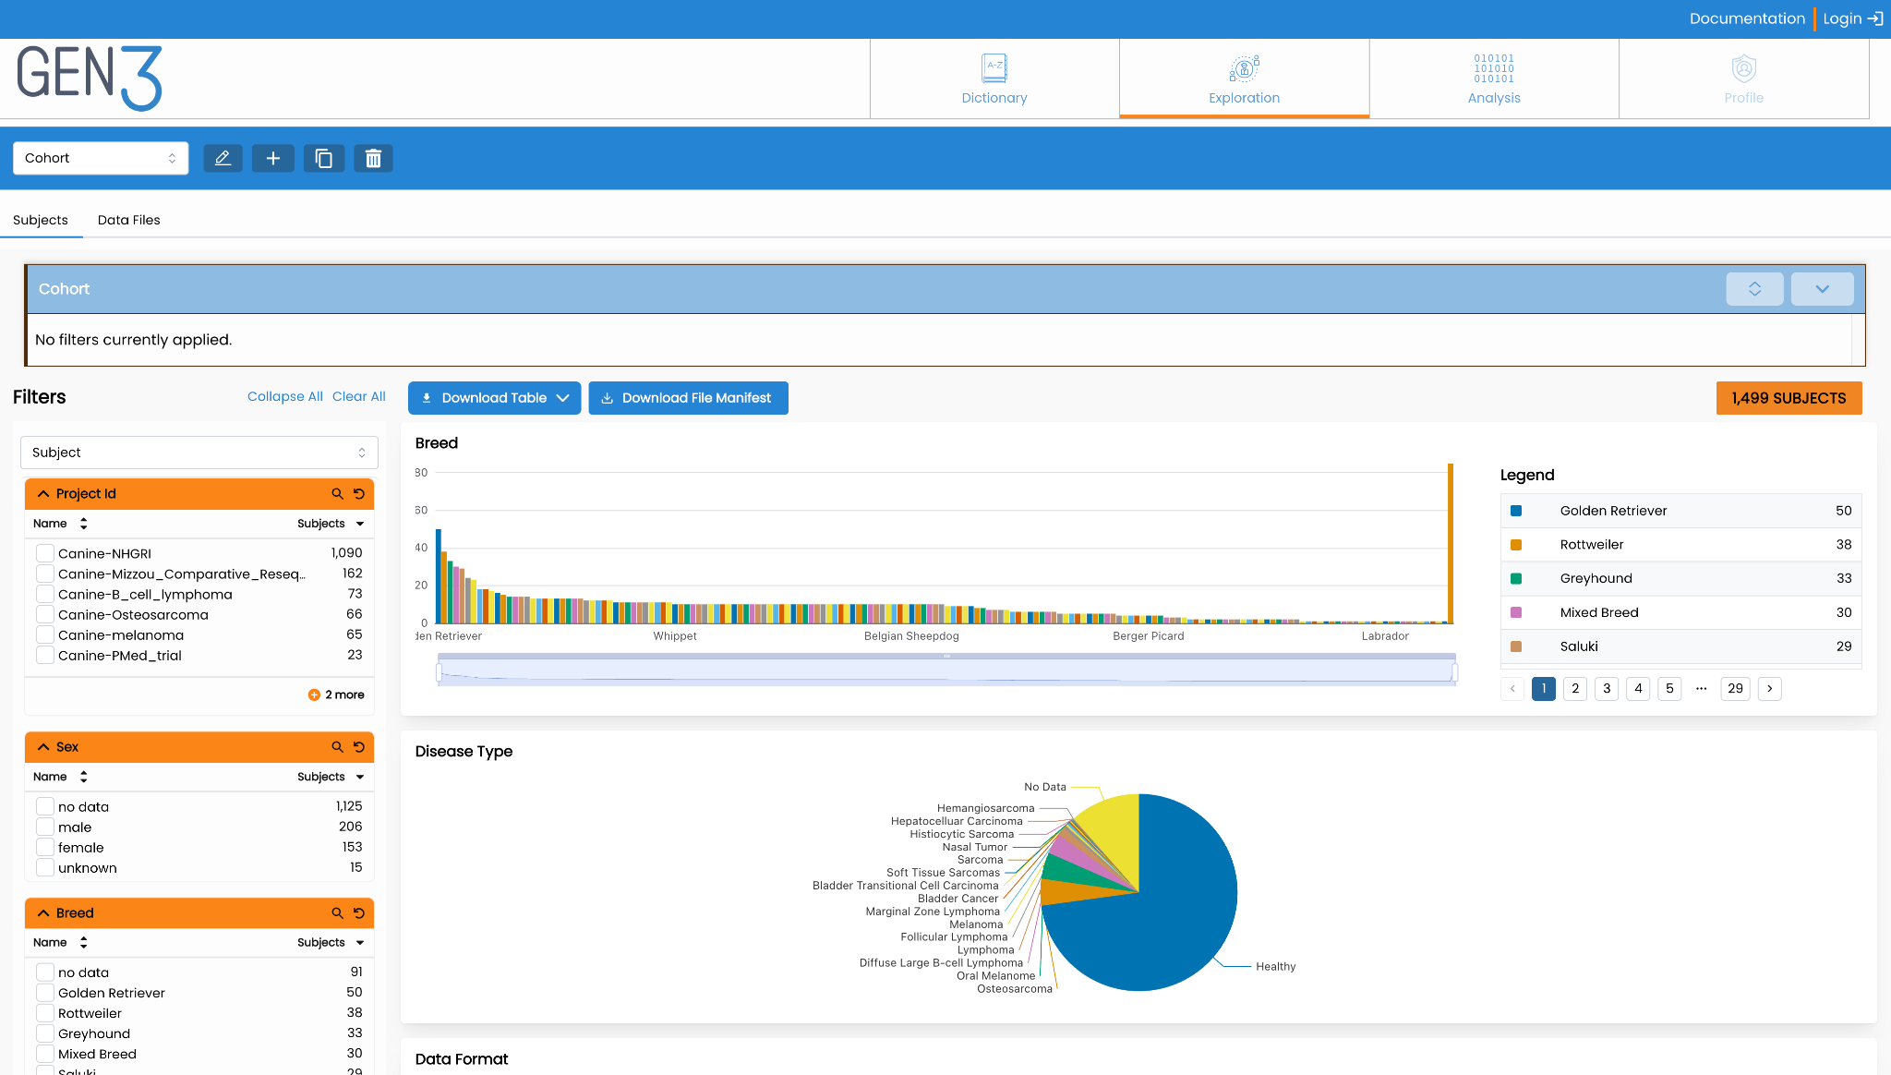
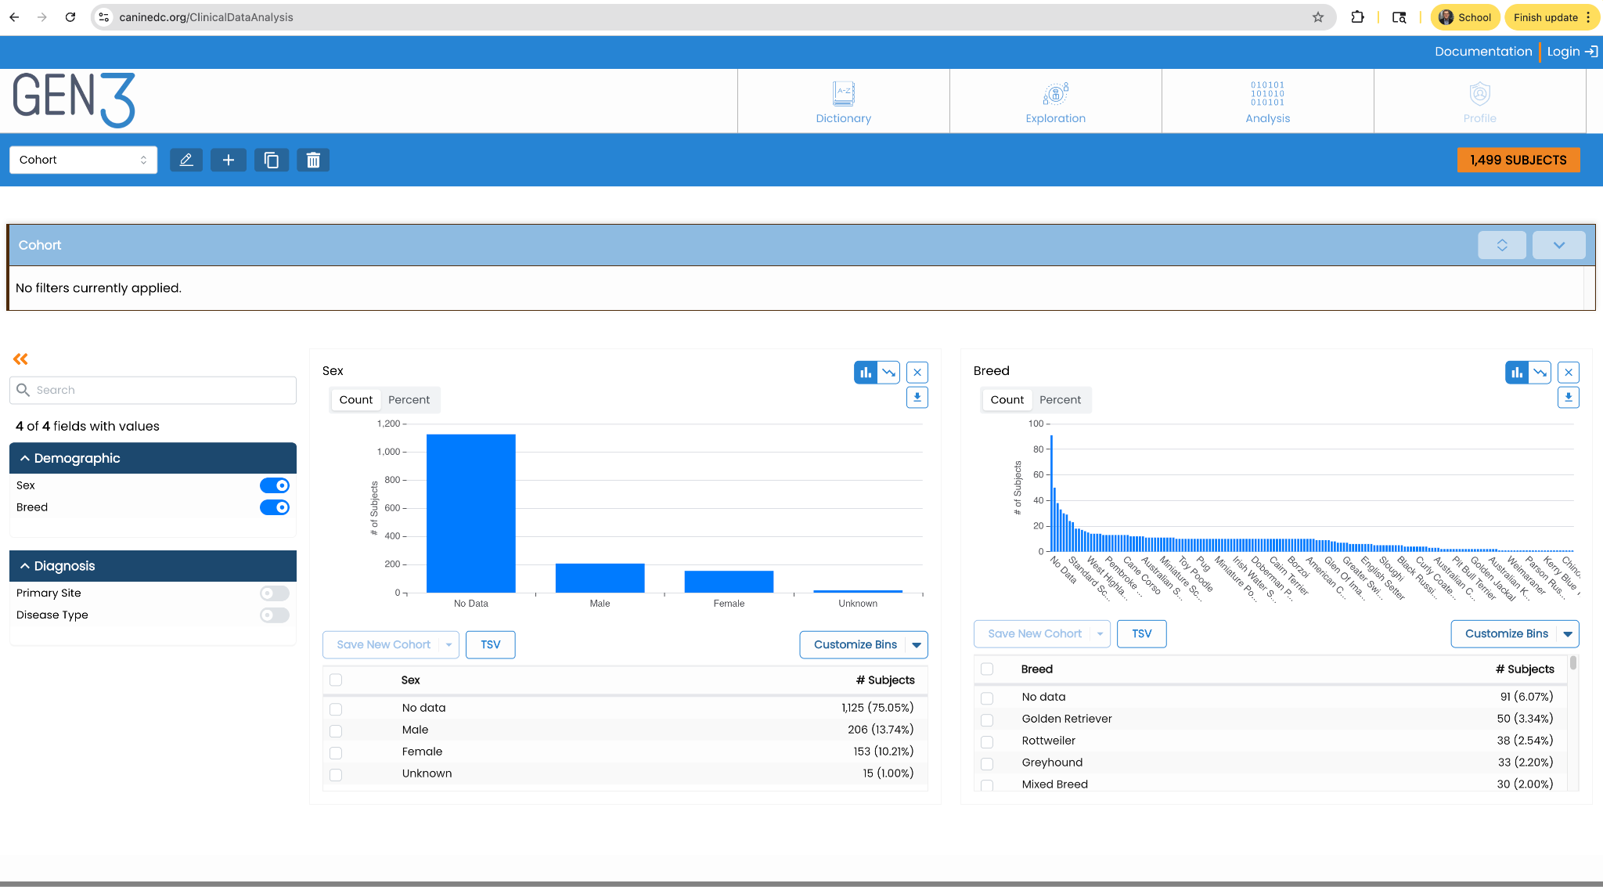
Gen3 Products - Data Commons
Data Commons are platforms that co-locate data analysis, exploration, and visualization tools with data management services for import and export of structured information like clinical, phenotypic, or biospecimen data, and data objects, like genomics data files or medical images.
Data Commons are capable of interoperating with other resources in a data mesh

Slide 9
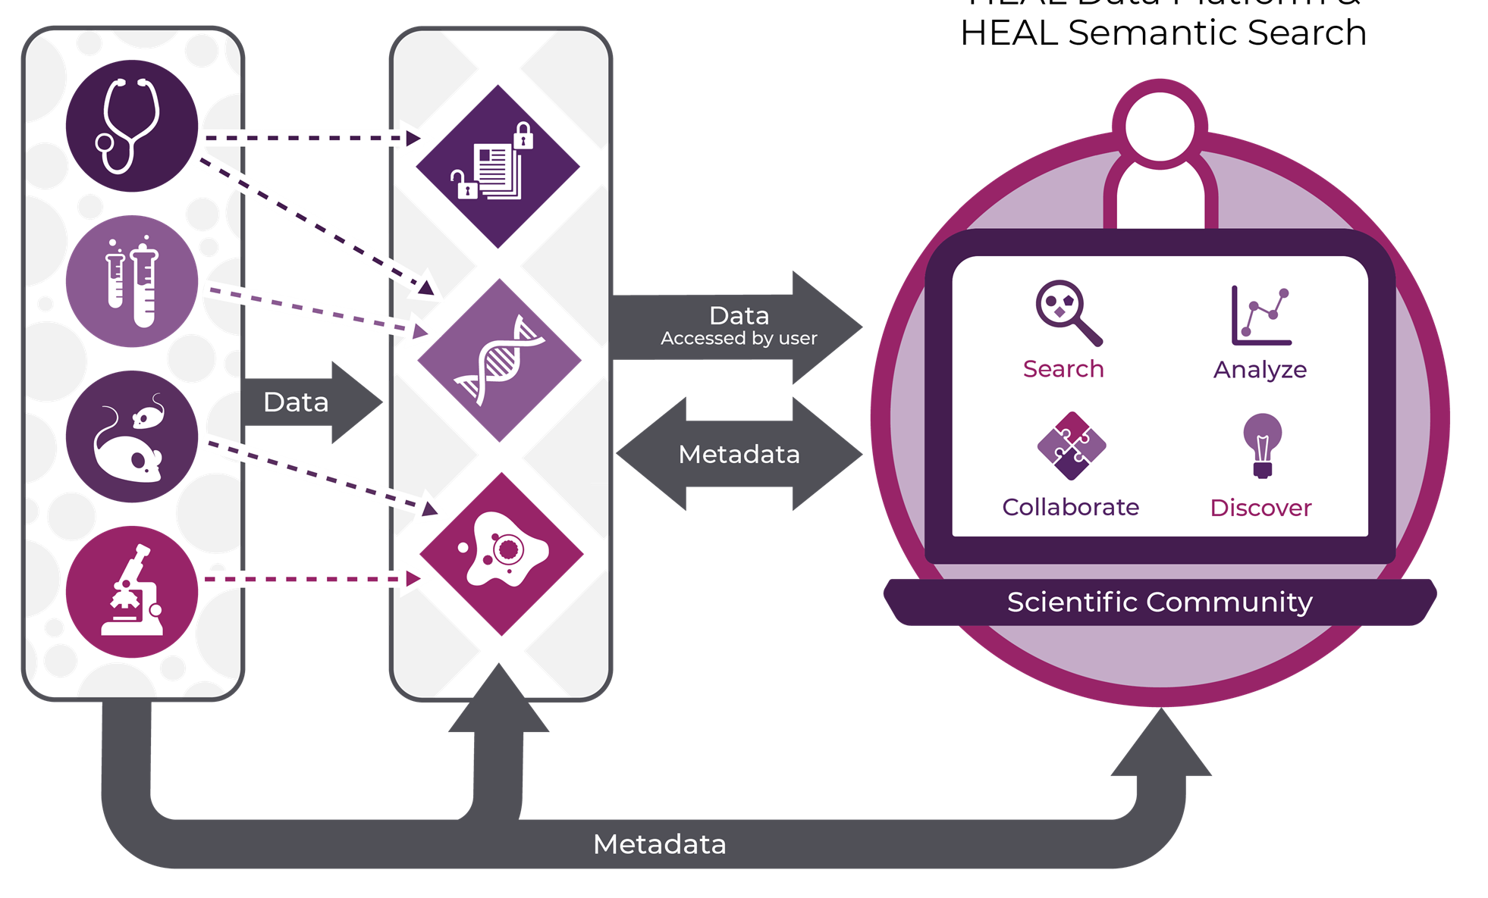

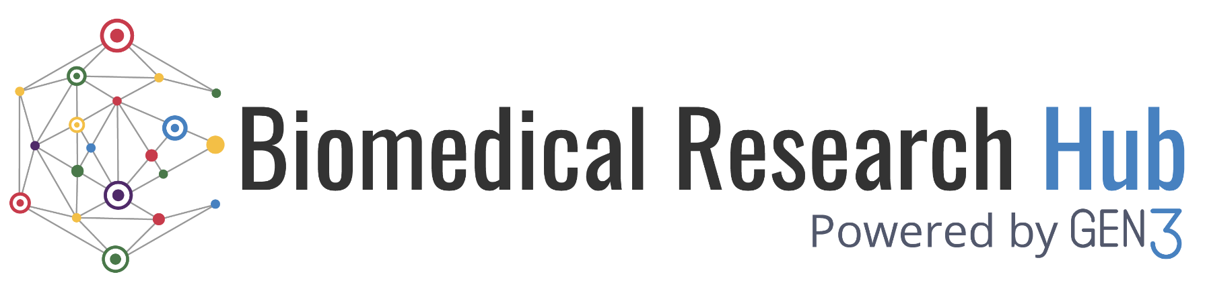

Gen3 Products - Data Meshes
A data mesh (aka data ecosystem or data fabric) consists of two or more data commons, data repositories, knowledgebases, and applications over a common set of services.
Mesh services are a minimal set of software services that provide open APIs for indexing data objects, associating metadata with the data objects, and controlling user access.
A data hub provides a single data discovery interface/API for finding and combining data across a data mesh.
Data Contributors
(research, clinical, gov’t, etc.)
Data Mesh / Nodes (interop repos, enclaves, etc.)
Gen3 Data Hub
Discovery Platform for
Search / Analysis Across Data Mesh
healdata.org
brh.data-commons.org
imaging-hub.data-commons.org

Slide 10
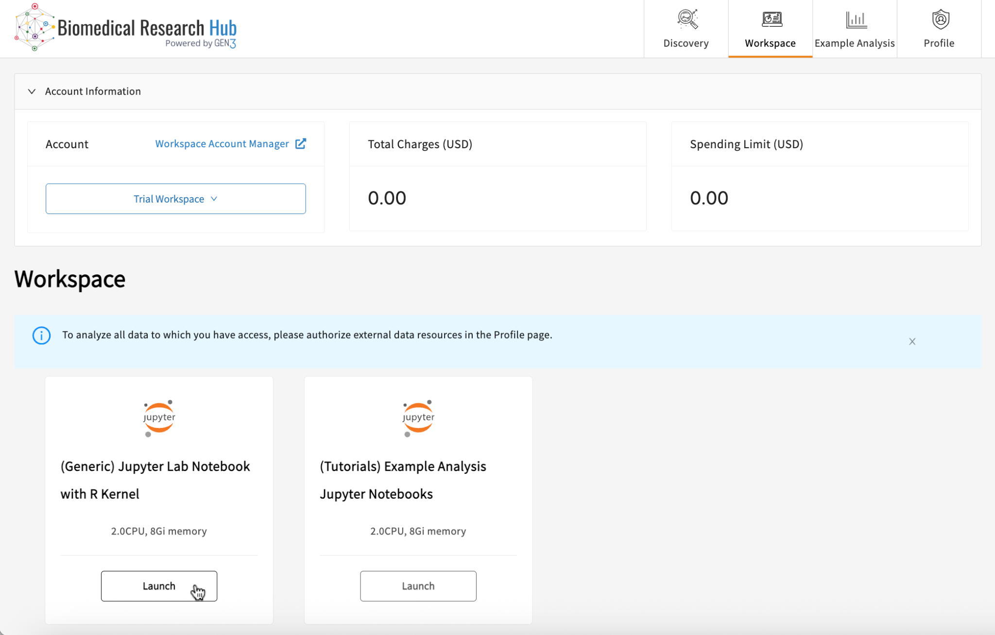
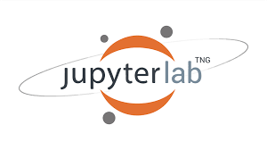
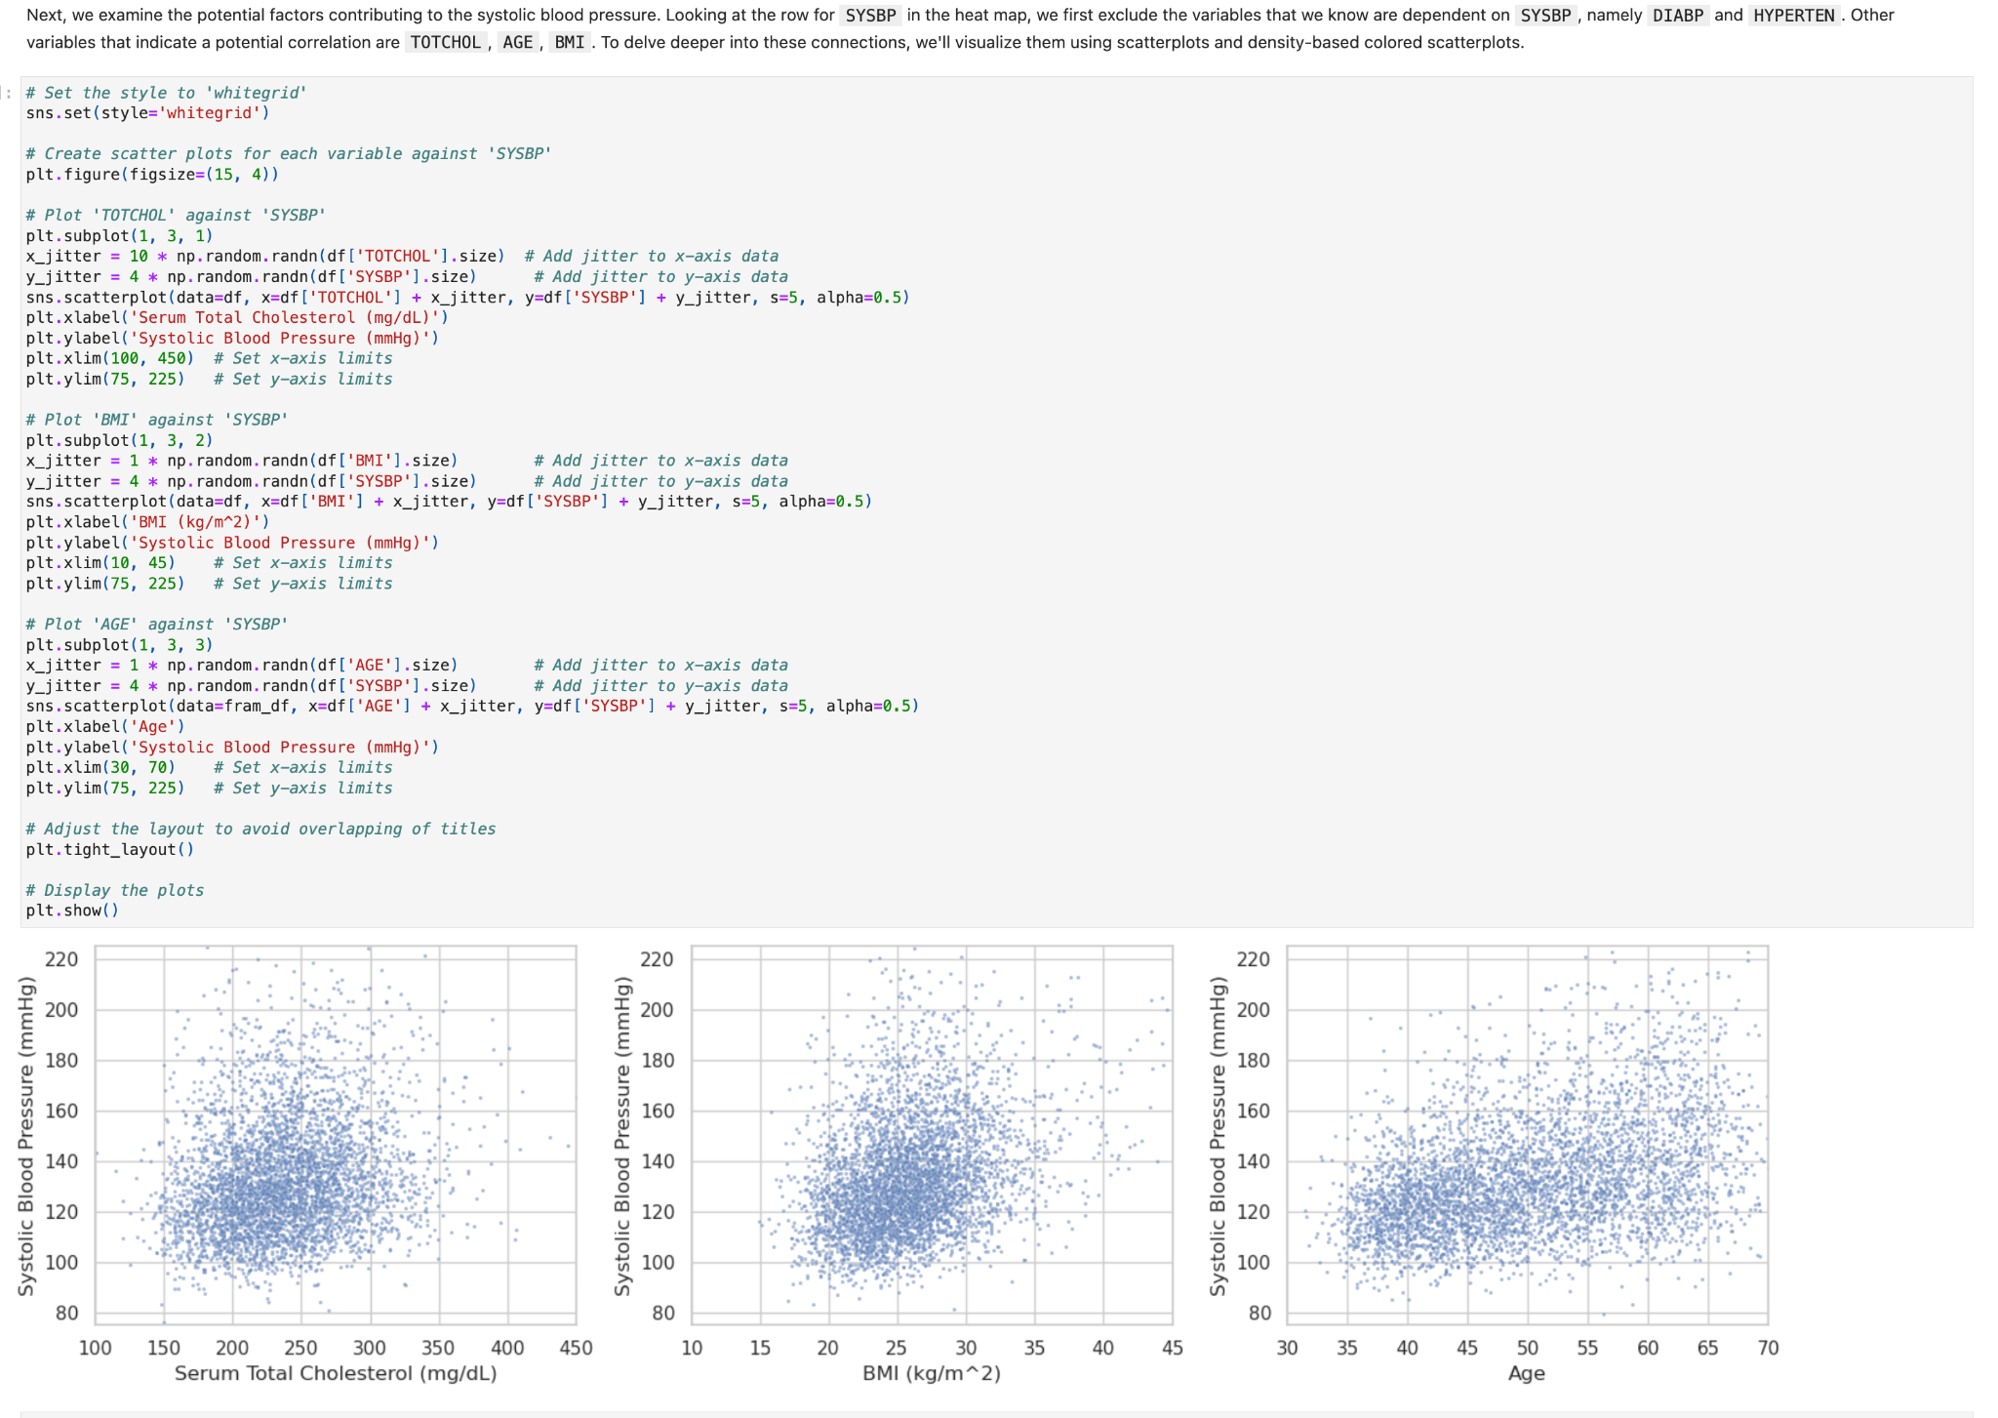
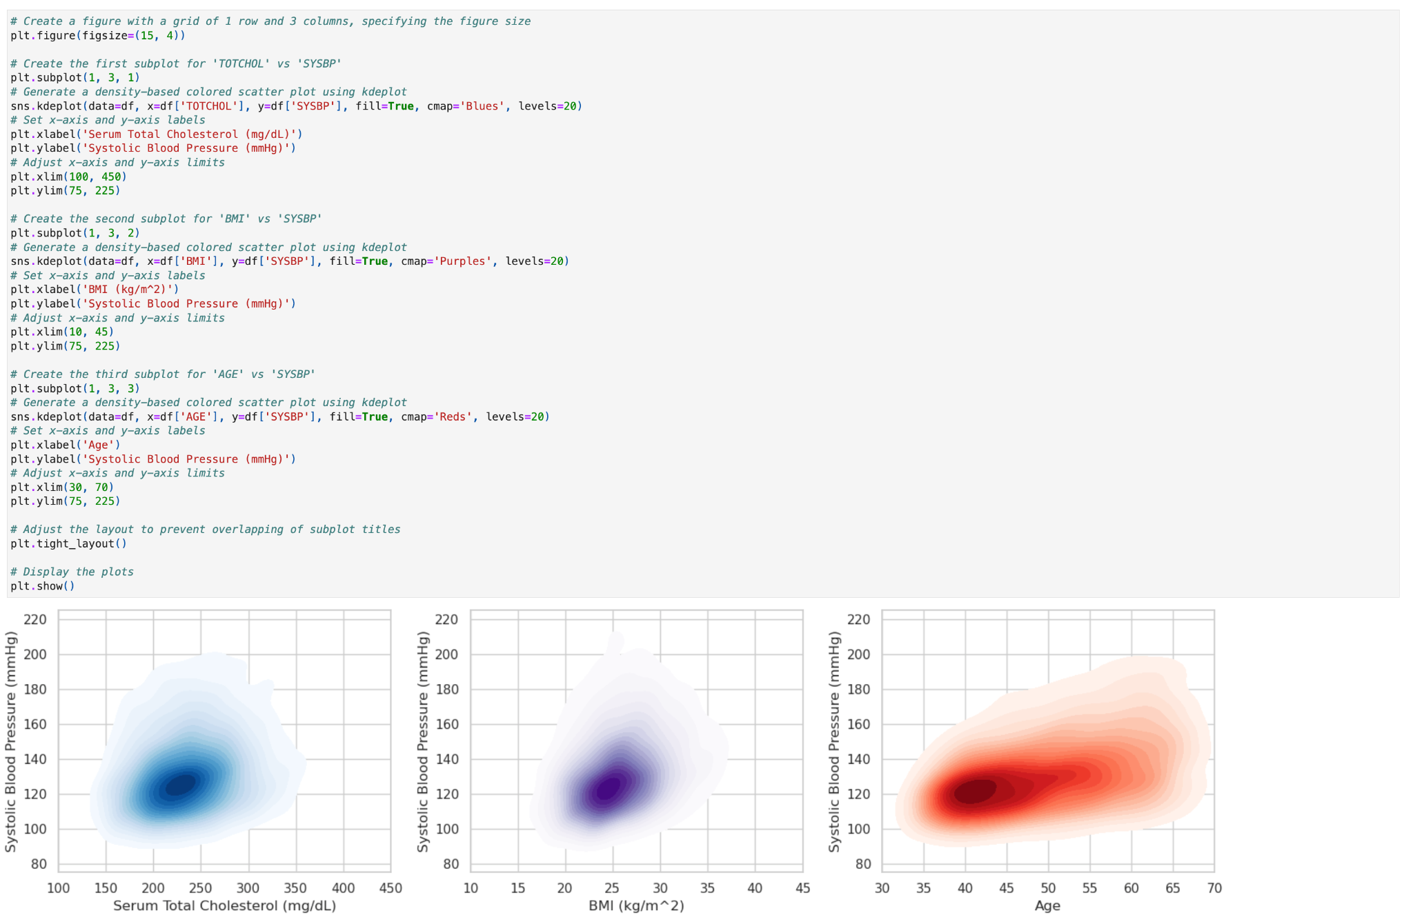
Gen3 Products - Workspaces
Workspaces are secure data analysis environments in the cloud that can access data from one or more data resources, including Data Commons.
By default, Gen3 Workspaces include Jupyter notebooks and RStudio but can be configured to host virtually any application, including analysis workflows, data processing pipelines, or data visualization apps.
Workspaces utilize the Gen3 Mesh Services for user authentication and authorization and for retrieving data objects and metadata from data resources

Slide 11
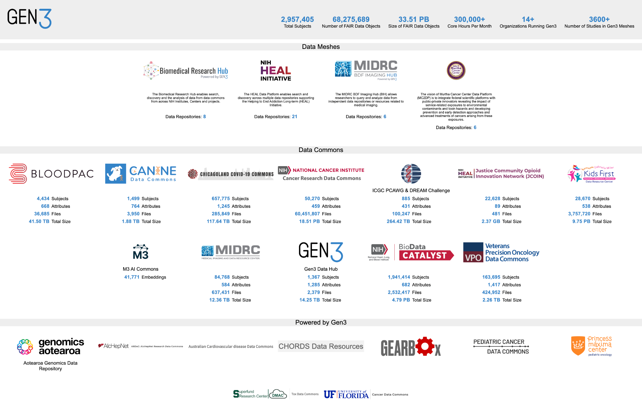
Gen3 Examples
stats.gen3.org

Slide 12
How to Use a Gen3 System
Using Gen3 Data Commons, Data Hubs, and Workspaces
Notes:
20m

Slide 13
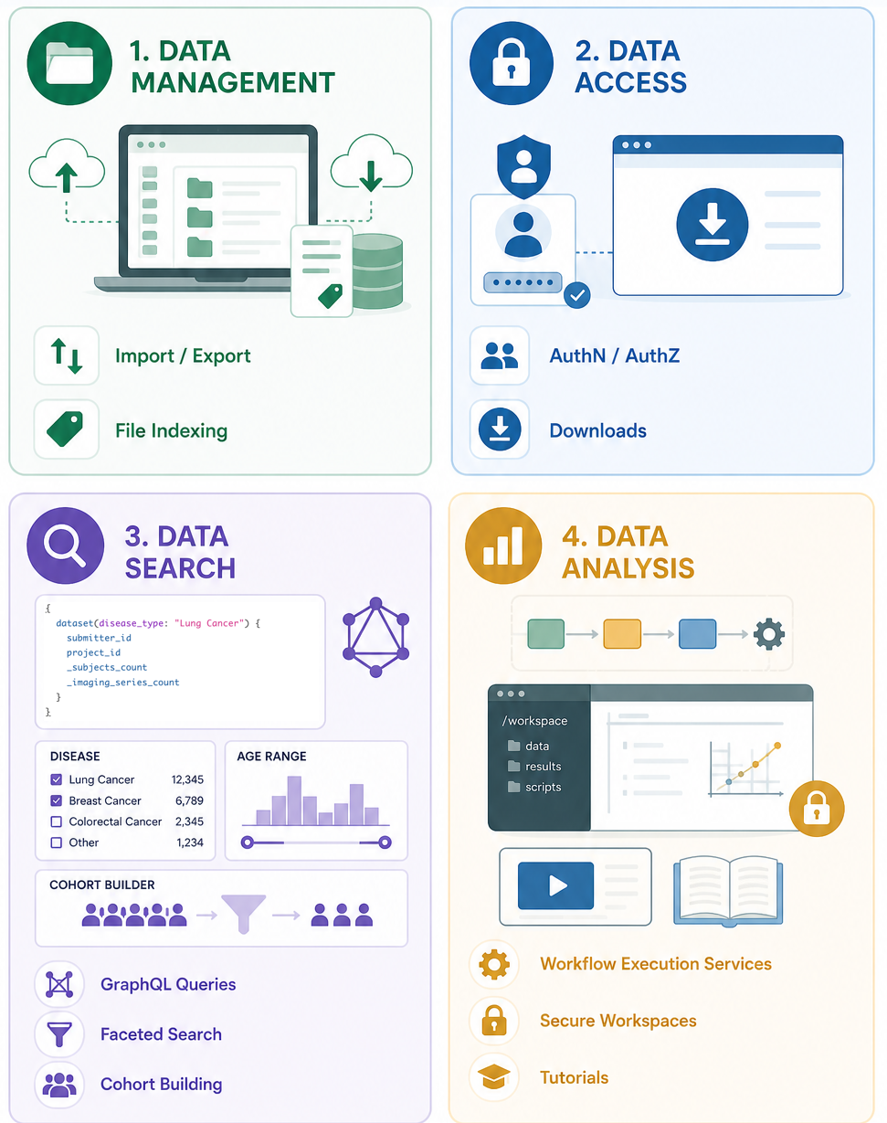
General Gen3 Capabilities / Functionality
Data Management
  Ingest structured / semi-structured data
  File upload / indexing
Data / Resource Access
  Tailoring AuthN / AuthZ
  Arborist UI
  File downloads
Data Search
  GraphQL queries
  Guppy ES queries
  Explorer UI
  Discovery UI
Data Analysis
  Custom Apps
  Resource Browser (Tutorial NBs / Examples)
  Workspaces
  WES / TES

Slide 14
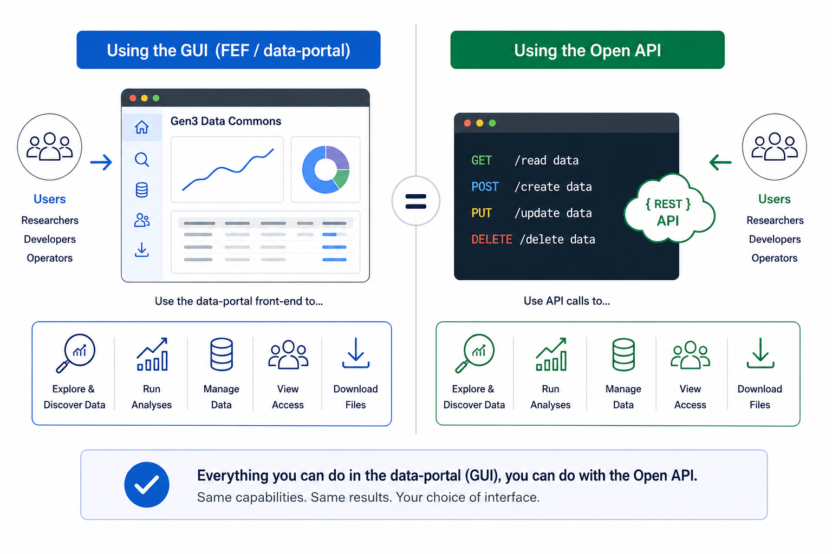
Gen3 UI vs API
Data Management
  Ingest data
  File upload / indexing
Data / Resource Access
  Tailoring Auth
  Arborist UI
  File downloads
Data Search
  GraphQL queries
  Guppy ES queries
  Explorer UI
  Discovery UI
Data Analysis
  Custom Apps
  Resource Browser
  Workspaces
  WES / TES

Slide 15
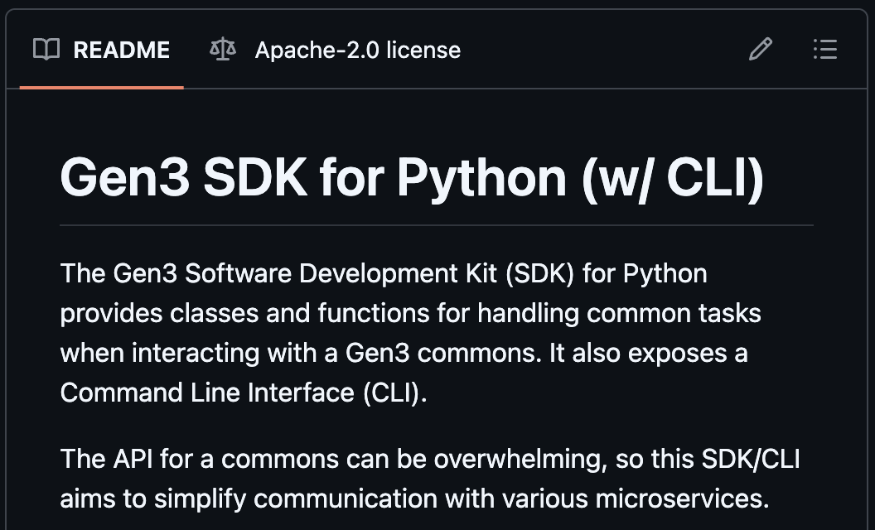
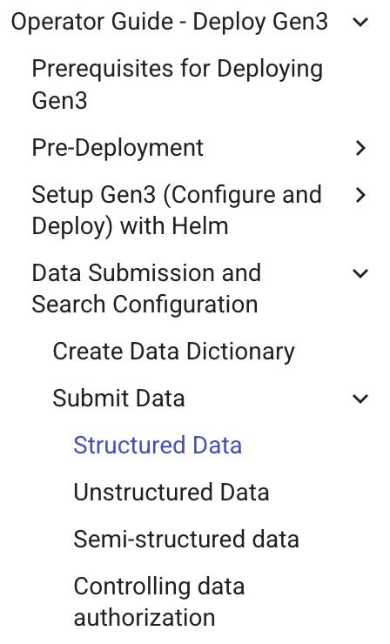
Gen3 Data Management Overview
File Indexing
  Data Lake: can make files accessible right away.
  Files uploaded to cloud storage or indexed in place (e.g., files already in a bucket / server)
  Files assigned unique PIDs (GUIDs / “object IDs”).
  Structured data linked via data GUIDs (UI flow).
Structured Data Ingestion
  Tables (column headers / rows of records) or JSON arrays of dictionaries (Key-value pairs).
  Harmonization through the data model.
  Includes foreign keys / links to parent nodes.
Semi-structured Data Ingestion / Aggregation
  Flexible: JSON format with any structure / nested keys.
  No links or hierarchy; just a list of records / PIDs.
  Can be discovery metadata (pubs / datasets, etc.), PPRL crosswalk data, package metadata (zip contents, etc).
github.com/uc-cdis/gen3sdk-python
Gen3 Operator Docs on Data Ingest
Gen3 Metadata Aggregation for Meshes / Hubs

Slide 16
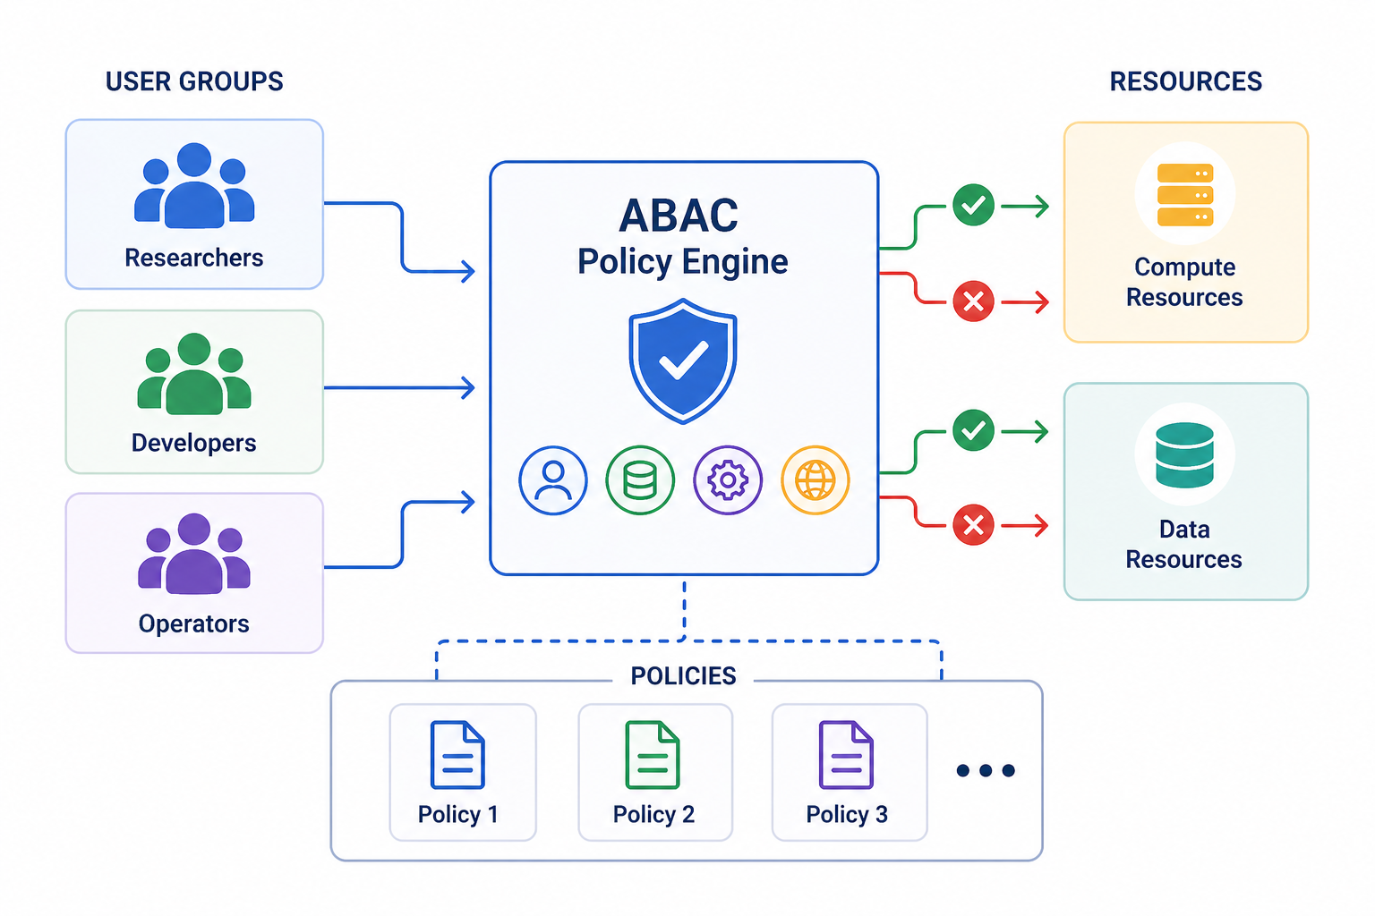
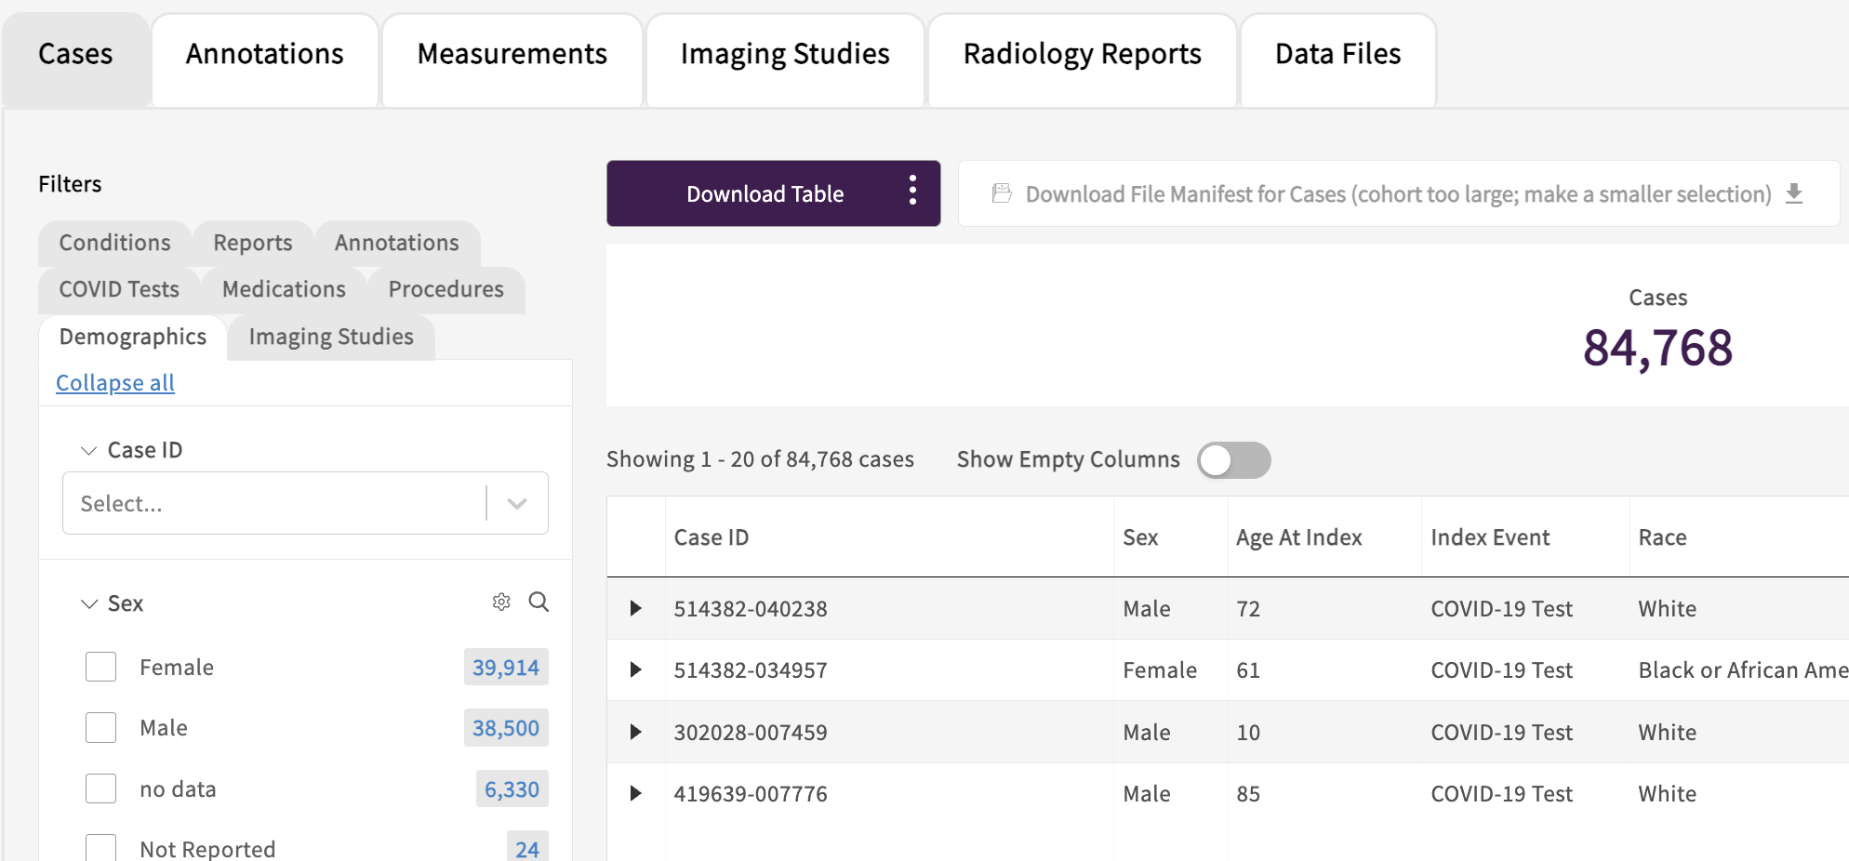
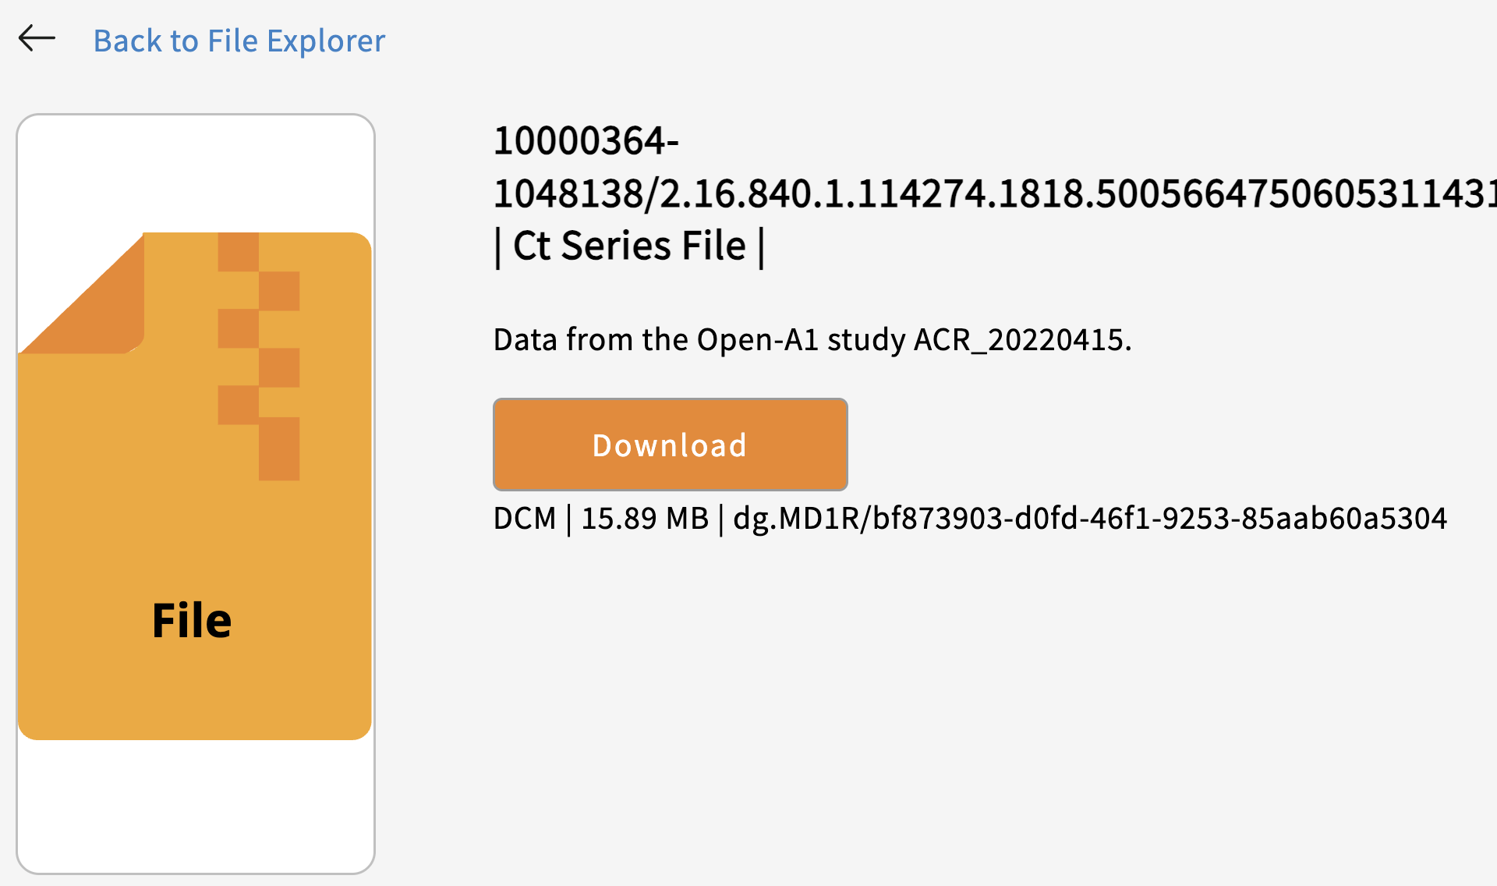
Gen3 Data Access Overview
Gen3 uses an ABAC (attribute-based access control) policy engine (arborist) to control user access to data, compute resources (workspaces, TES) and UI components
Manage whitelists in YAML or interface with dbGaP, etc.
Structured data is accessed via queries and the “Explorer” page; sheepdog service can export structured data tables.
Semi-structured data is accessed from the “Discovery” page (MDS); files associated with a record can also be downloaded or exported to workspaces via buttons here.
Files are accessed via their GUIDs using /files/<guid> endpoint from within data portal, the drs-pull function in the Gen3 Python SDK, or using the gen3-client command-line tool.

Slide 17
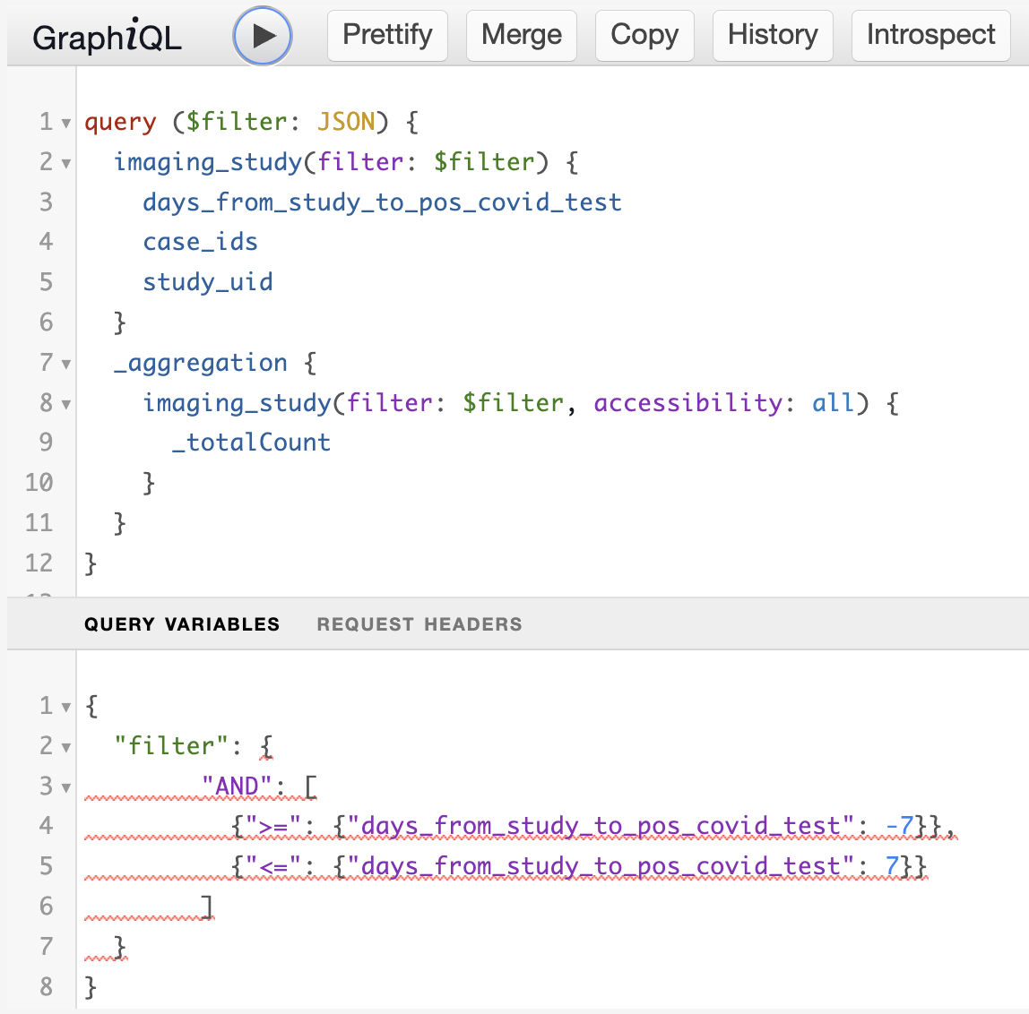
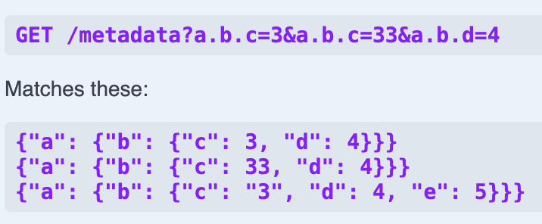
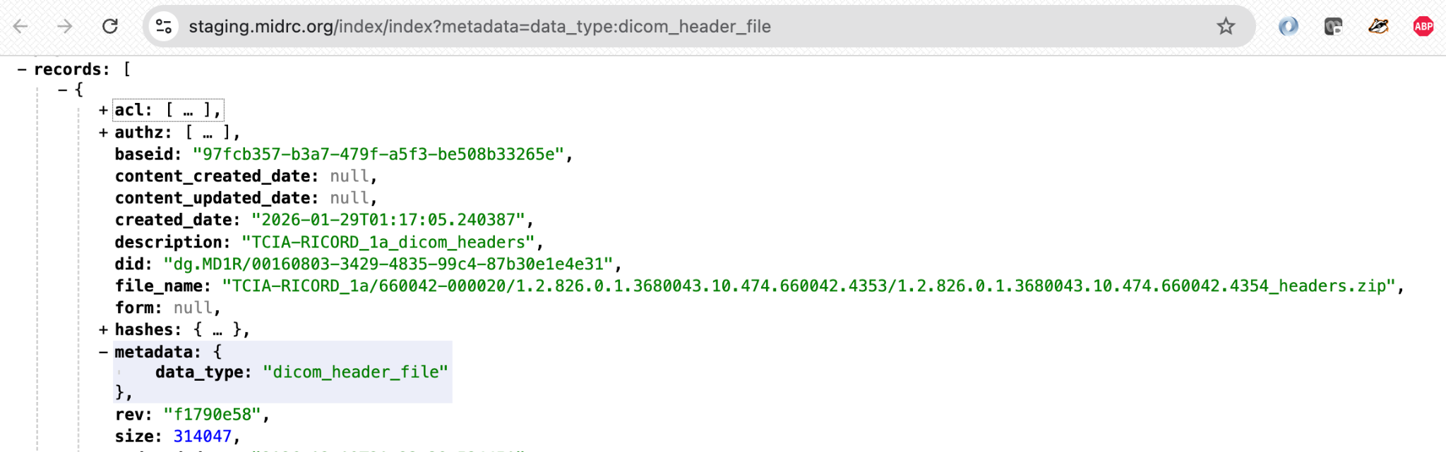
Gen3 Data Search Overview
Structured Data Queries (peregrine & guppy services)
  Relies on the data model (PostGRES / peregrine) and ETL mapping (Elasticsearch / guppy)
  GraphQL-like functionality: supports querying relationships across nodes, filters, multiple operators.
  Guppy supports downloading the entire ES index; for PostGRES, sheepdog handles export of tables
  Query page provides an interactive query-builder / schema-viewer
Semi-structured Data Queries (metadata service)
  Provide key-value pair to return matching records.
  Support aliases, e.g., when using cross-walk services (finding IDs for patients/samples across repositories).
Unstructured Data Queries (Files)
  Files can only be searched using the indexd service
  File metadata is searched; cannot search file contents.

Slide 18
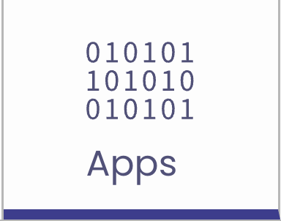
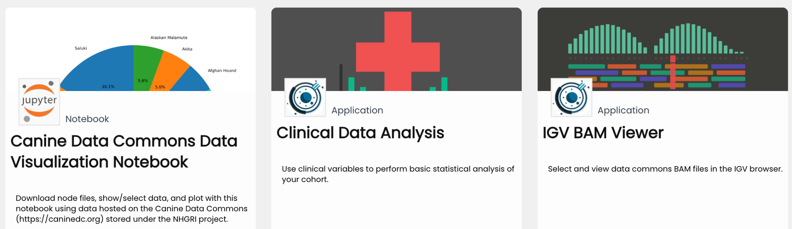
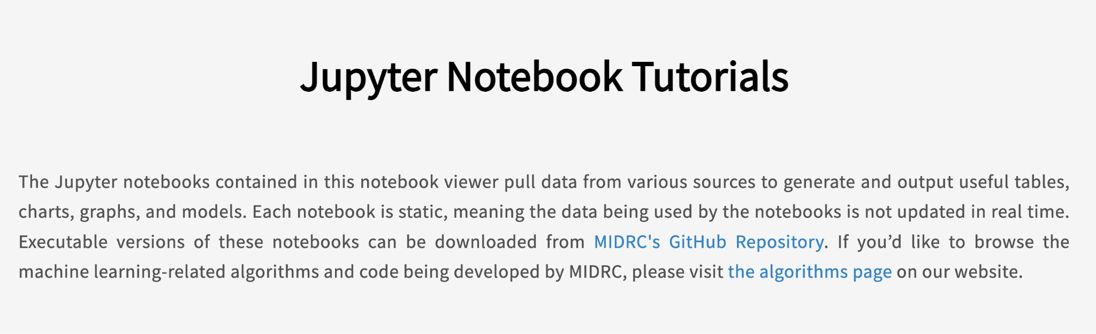
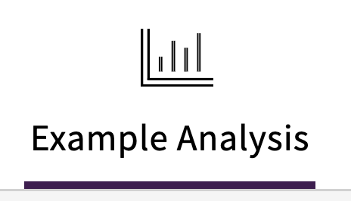
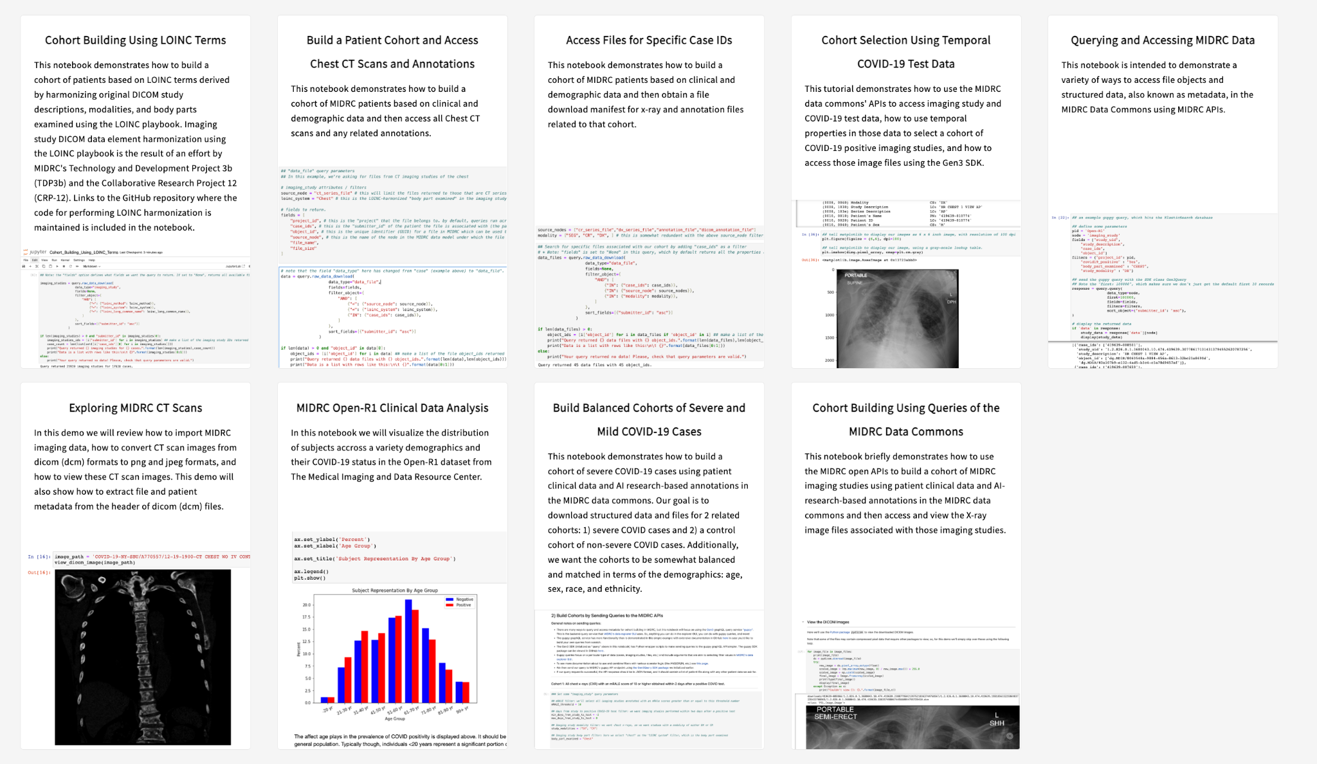
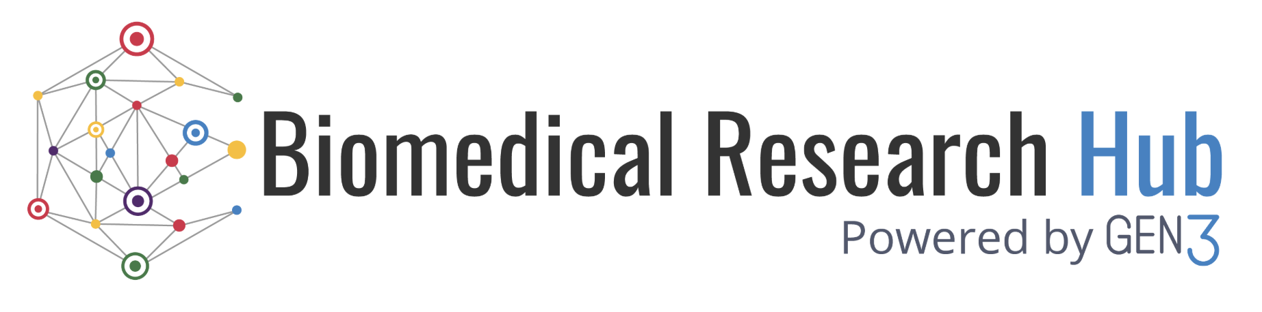
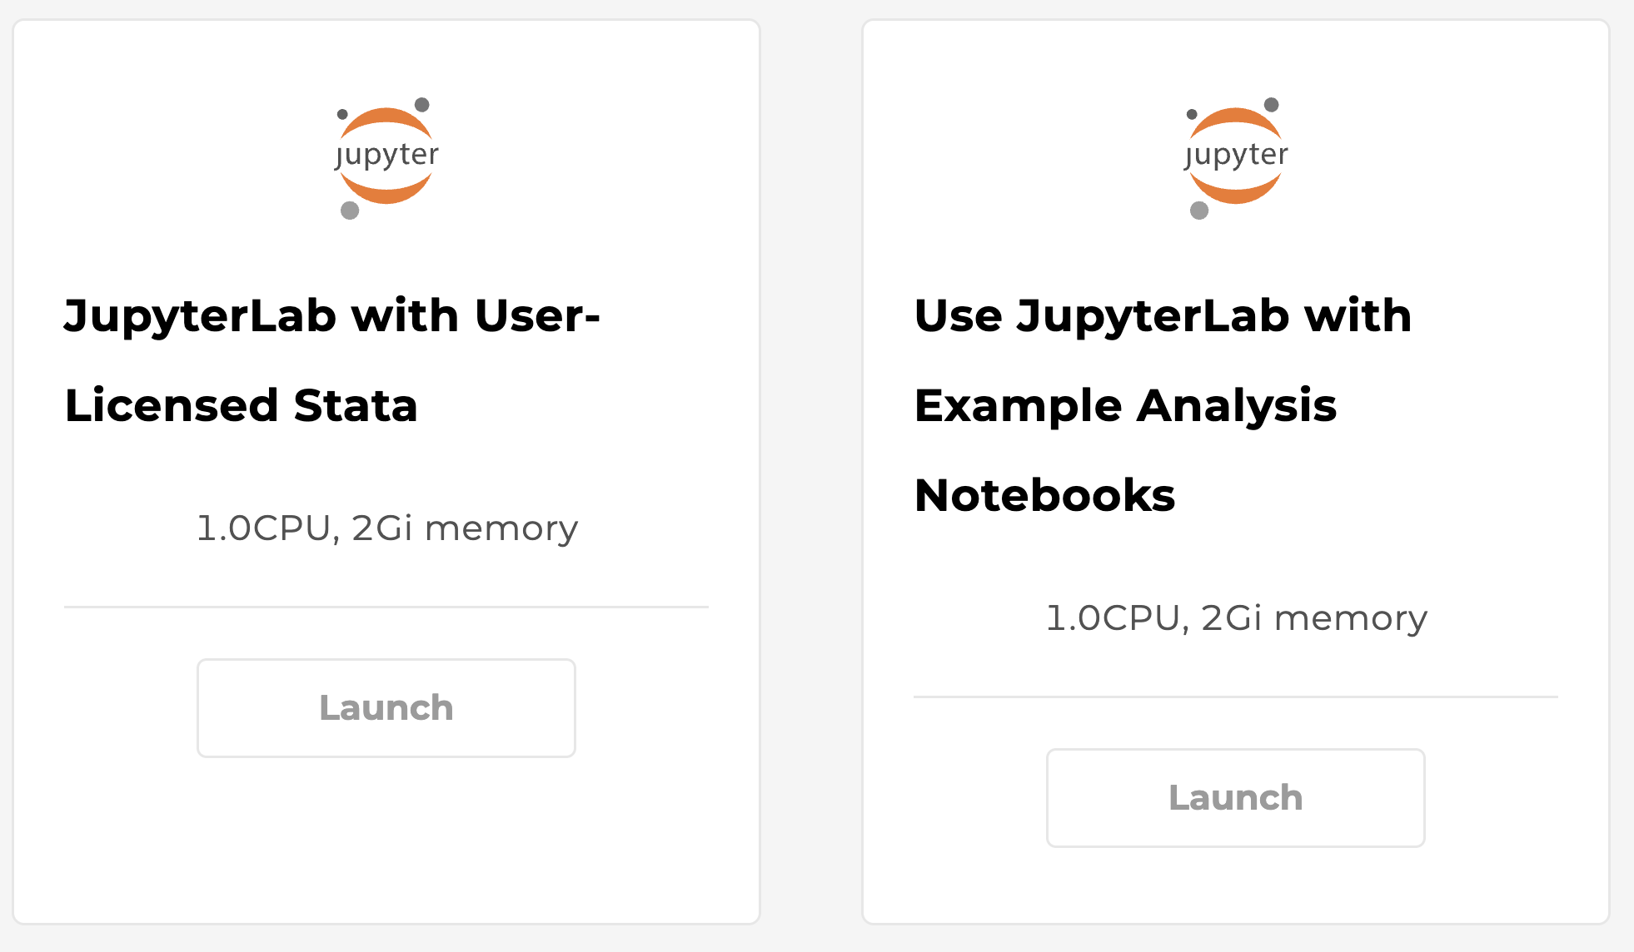
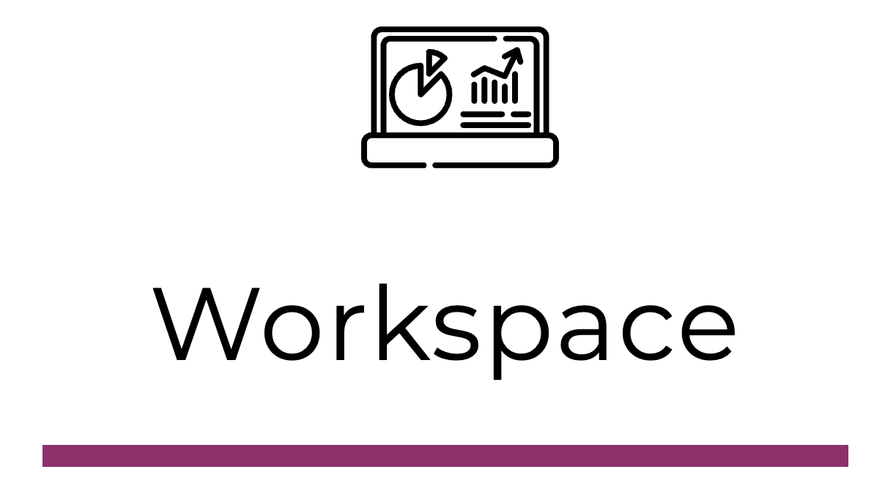

Gen3 Data Analysis Overview
Custom Apps
Resource Browser
  Provide tutorials / examples for researchers.
Workspaces
  Provide analysis VMs with JupyterLab and R studio.
  Load with tutorial notebooks.
Task Execution Service
  Run a NextFlow analysis pipelines over data in a commons (in test).

Slide 19
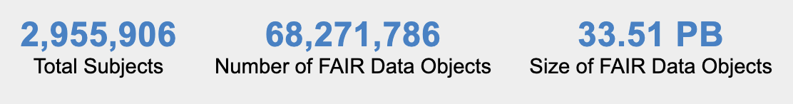



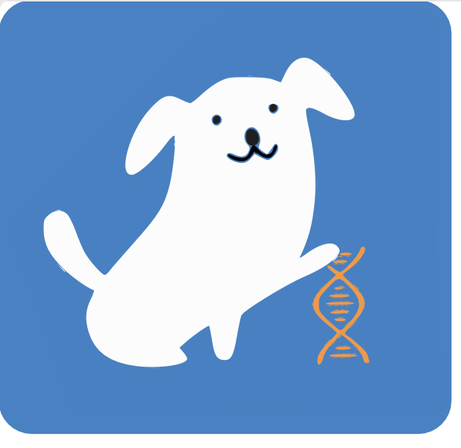

Using Gen3 Data Commons
Data Management
  File uploads / indexing
  Structured data ingestion
  Semi-structured data: metadata service / cross-walk
Data Search
  Exploration Page
  Query Page
  Discovery Page
Data Access
  Files: manifests, files endpoint and DRS downloads
  Structured data / metadata export
Data Analysis
  Custom Apps
  Resource Browser
  Workspaces
  Task Execution Service
stats.gen3.org
data.midrc.org
data.bloodpac.org
gen3.biodatacatalyst.nhlbi.nih.gov
vpodc.data-commons.org
caninedc.org

Slide 20

Using Gen3 Data Hubs
Data Management
  Discovery metadata aggregation across the data mesh using API adapters
  Less typical: metadata agg + data model / structured data and file upload
Data Search
  Discovery Page: tag-based and free-text search over semi-structured metadata
  Explorer Page: faceted search interface supports multiple views / data types
Data Access
  Data file access is managed by host platforms in the mesh: users discover data in the hub, which contains PIDs / URLs / pointers to data files; users then use host platforms to access or Gen3 Workspace pulls data on user’s behalf
Data Analysis
  Hubs typically provide Gen3 workspaces where users can perform exploratory data analysis.
  Mesh nodes hosting files can receive and run analysis pipelines over their data, which doesn’t move, via the Task Execution Service (TES) (*in test).
imaging-hub.data-commons.org
healdata.org
brh.data-commons.org

Slide 21
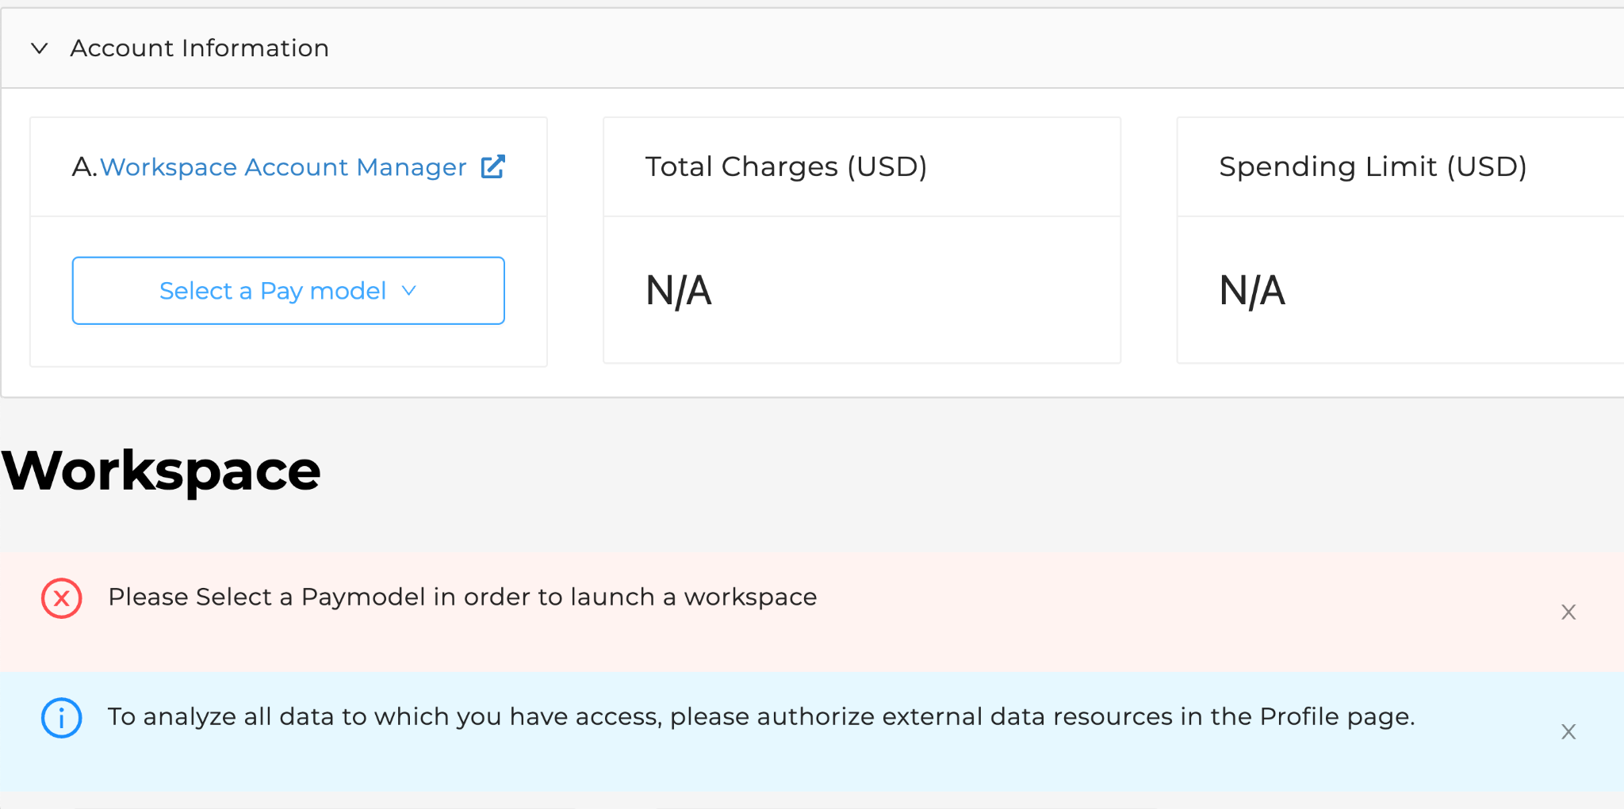
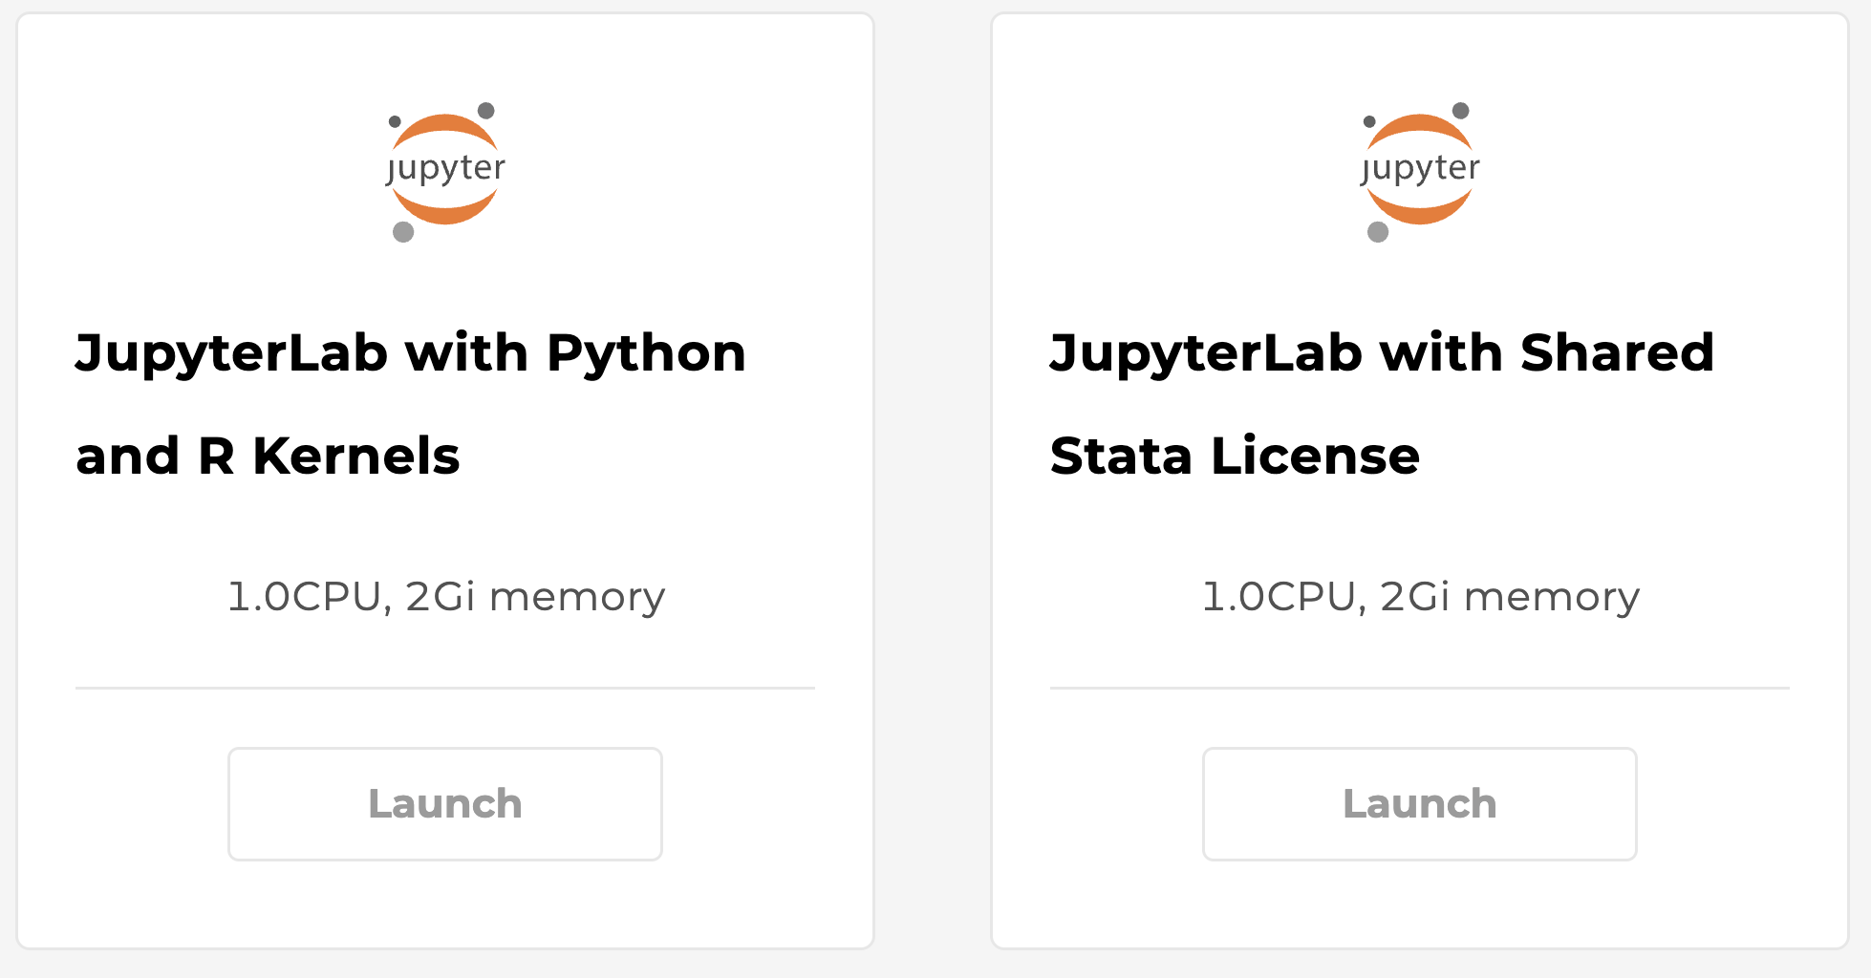
Using Gen3 Workspaces
Configuring workspace images
  Docker images can be loaded with various SW tools, packages and tutorials.
  Different flavors of VMs with varying compute resources can be offered to users.
Launching a workspace image
  Users choose a workspace flavor/image based on their needs and preferences.
  If pay model is turned on, users must select how they will pay for the workspace usage (e.g., grants, STRIDES credits or credit card, etc.)
Performing data analysis
  Users typically run a JupyterLab notebooks (Python kernel); R and Stata kernels are also available.
  Users save their notebooks, results and artifacts in a persistent drive, which is mounted the next time they launch a workspace; these can also be downloaded locally.
healdata.org

Slide 22
Gen3 Architecture and Deployment

Slide 23
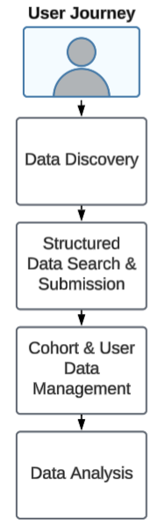
Gen3 Architecture
Gen3 is composed of many interacting services that power different aspects of the platform
Gen3 is composed of UI components (frontend) and APIs (application programming interfaces)
  The API is powered by backend services
They can all be deployed together or individually depending on your use case
New updates are released on a monthly basis
Additional information on key services can be found here
Notes:
Check out Gen3 paper on ArXiv

Slide 24
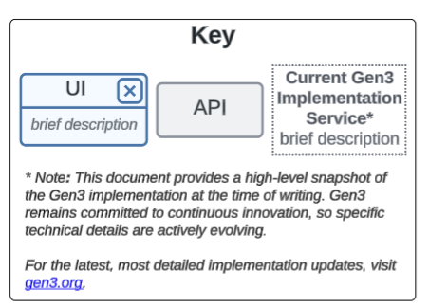
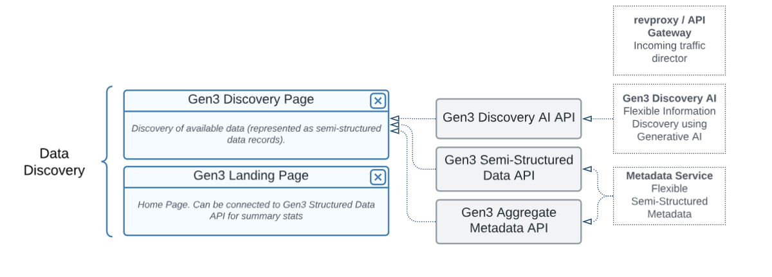
Data Discovery
Data Discovery -> Structured Data Search & Submission -> Cohort & User Data Management -> Data Analysis
Notes:
Check out Gen3 paper on ArXiv

Slide 25
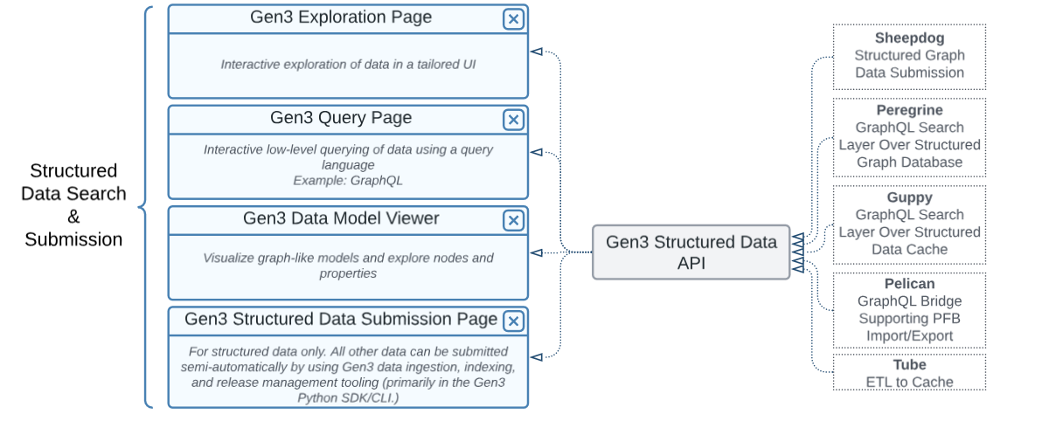
Structured Data Search & Submission
Data Discovery -> Structured Data Search & Submission -> Cohort & User Data Management -> Data Analysis

Slide 26
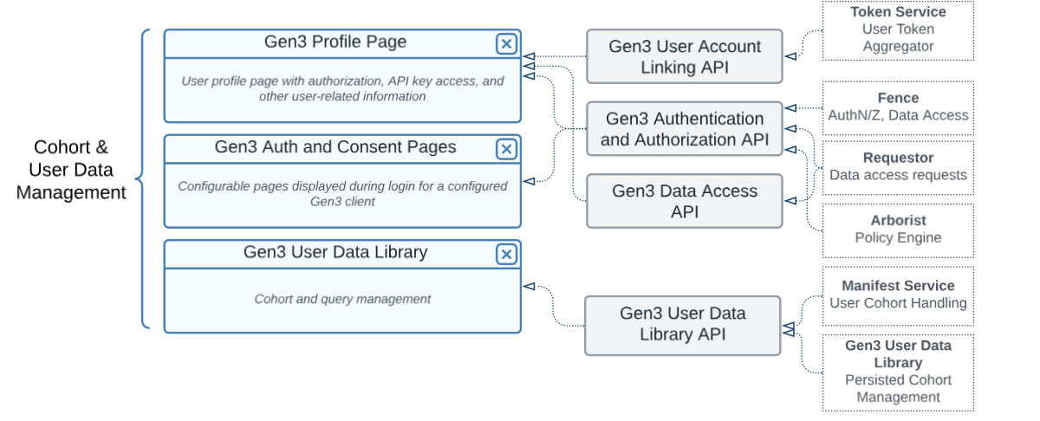
Cohort & User Data Management
Data Discovery -> Structured Data Search & Submission -> Cohort & User Data Management -> Data Analysis

Slide 27
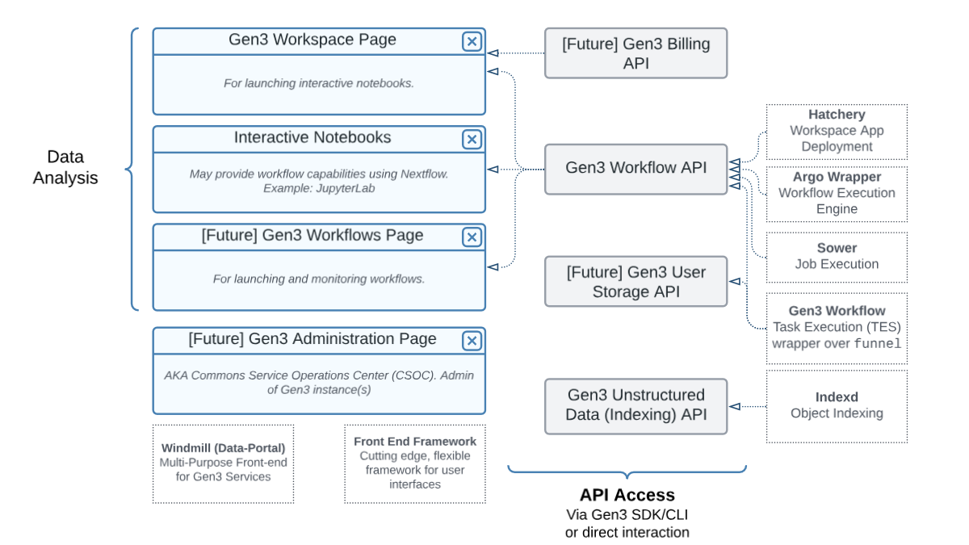
Data Analysis
Data Discovery -> Structured Data Search & Submission -> Cohort & User Data Management -> Data Analysis

Slide 28



Technical Details
Open-source (Apache 2.0)
GitHub
Microservice Architecture
Services dockerized, Kubernetes (k8s) for orchestration
Mostly Python-based web apps with standards-based RESTful APIs
Some Golang web apps with standards-based RESTful APIs
Working to better standardize configuration and ease of deployment

Slide 29

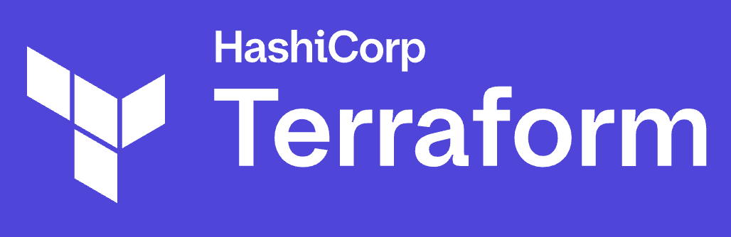
Deployment
A Kubernetes environment is needed for deployment. This can be set up in AWS using example Terraform modules, but can also be set up in any cloud or kubernetes-enabled environment including on-prem.
Deployment of Gen3 is managed using Helm, which is a Kubernetes package manager

Slide 30
What is Helm used for?
Defining Deployments: Helm uses configuration files called charts to define how Gen3 components should be deployed. These charts encapsulate the necessary configuration, dependencies, and deployment logic.
Installation: Helm streamlines the process of installing Gen3 components into your Kubernetes cluster. With Helm, you can easily deploy Gen3 services, databases, and other essential components.
Configuration Management: Helm simplifies the management of configuration settings for Gen3 services. You can customize settings, such as database connection details, service replicas, and more, through Helm values.
Upgrades and Rollbacks: As Gen3 evolves, Helm enables you to effortlessly upgrade your deployment to the latest versions. In case of issues, it also provides the ability to roll back to previous configurations.

Slide 31
Gen3 Security
CTDS operates Gen3 systems at FedRAMP Moderate
  Annual security & compliance audits by third parties
  Annual Penetration Tests
  Follows FISMA NIST 800-54 Revision 5
SecDevOps
  CTDS follows a SecDevOps culture, embedding security and privacy protections in design, coding, testing & operations.
  All code / software vetted to minimize risks and vulnerabilities.
Other Gen3 operators must follow their own relevant compliance framework depending on their institution, country, and type of data

Slide 32
How to Contribute to Gen3

Slide 33
Different Ways to Contribute to Gen3
Contribute to the source code
  Gen3 source code
  Instructions on how to contribute
Participate in the community
  Join the Gen3 Slack - Request access here
  Participate in the Gen3 Community Forum - See past events here
Contribute to documentation
  Gen3 Technical Documentation
  To make modifications create a pull request in the docs-gen3 repo
Submit Feature Requests or Bug Reports as GitHub issues
  Open in the most appropriate repo, but use Gen3 Community Repo if you are not sure about the best place to submit.

Slide 34
References
Gen3 Technical Documentation
Gen3 overview paper on arXiv
Gen3.org
GitHub
Gen3 Slack
“How does Gen3…” blog series
Support email: support@gen3.org

Slide 35
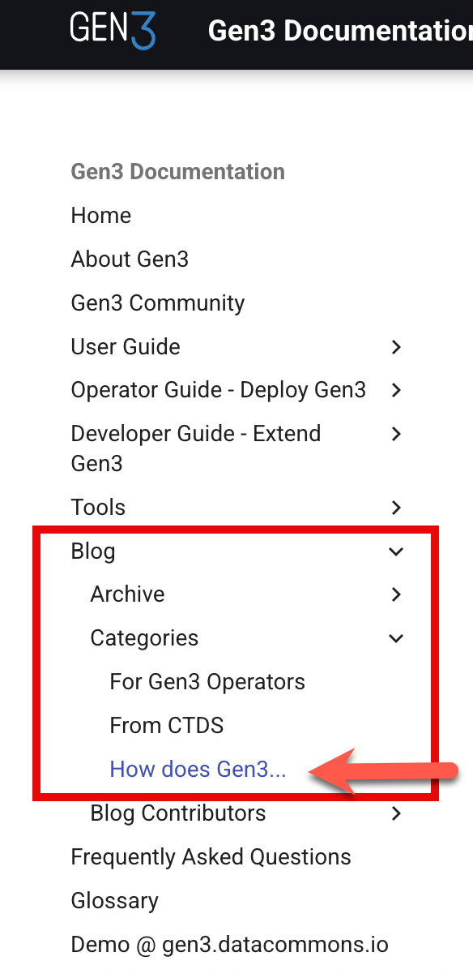
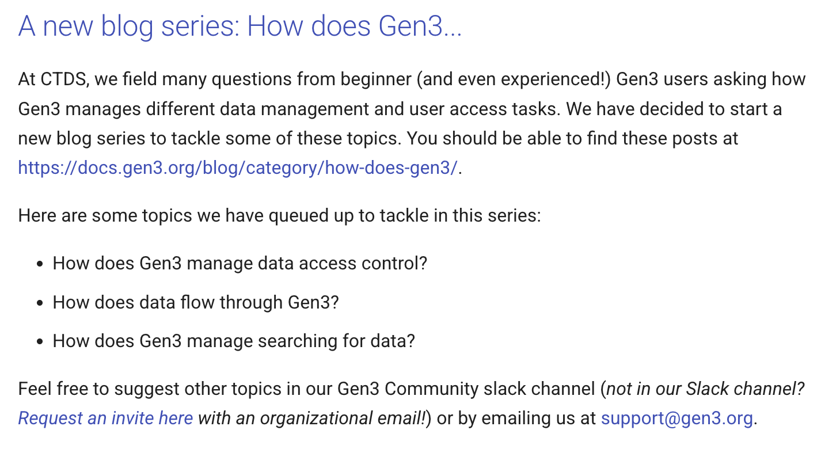
New Series: “How does Gen3…”

